Slide 1
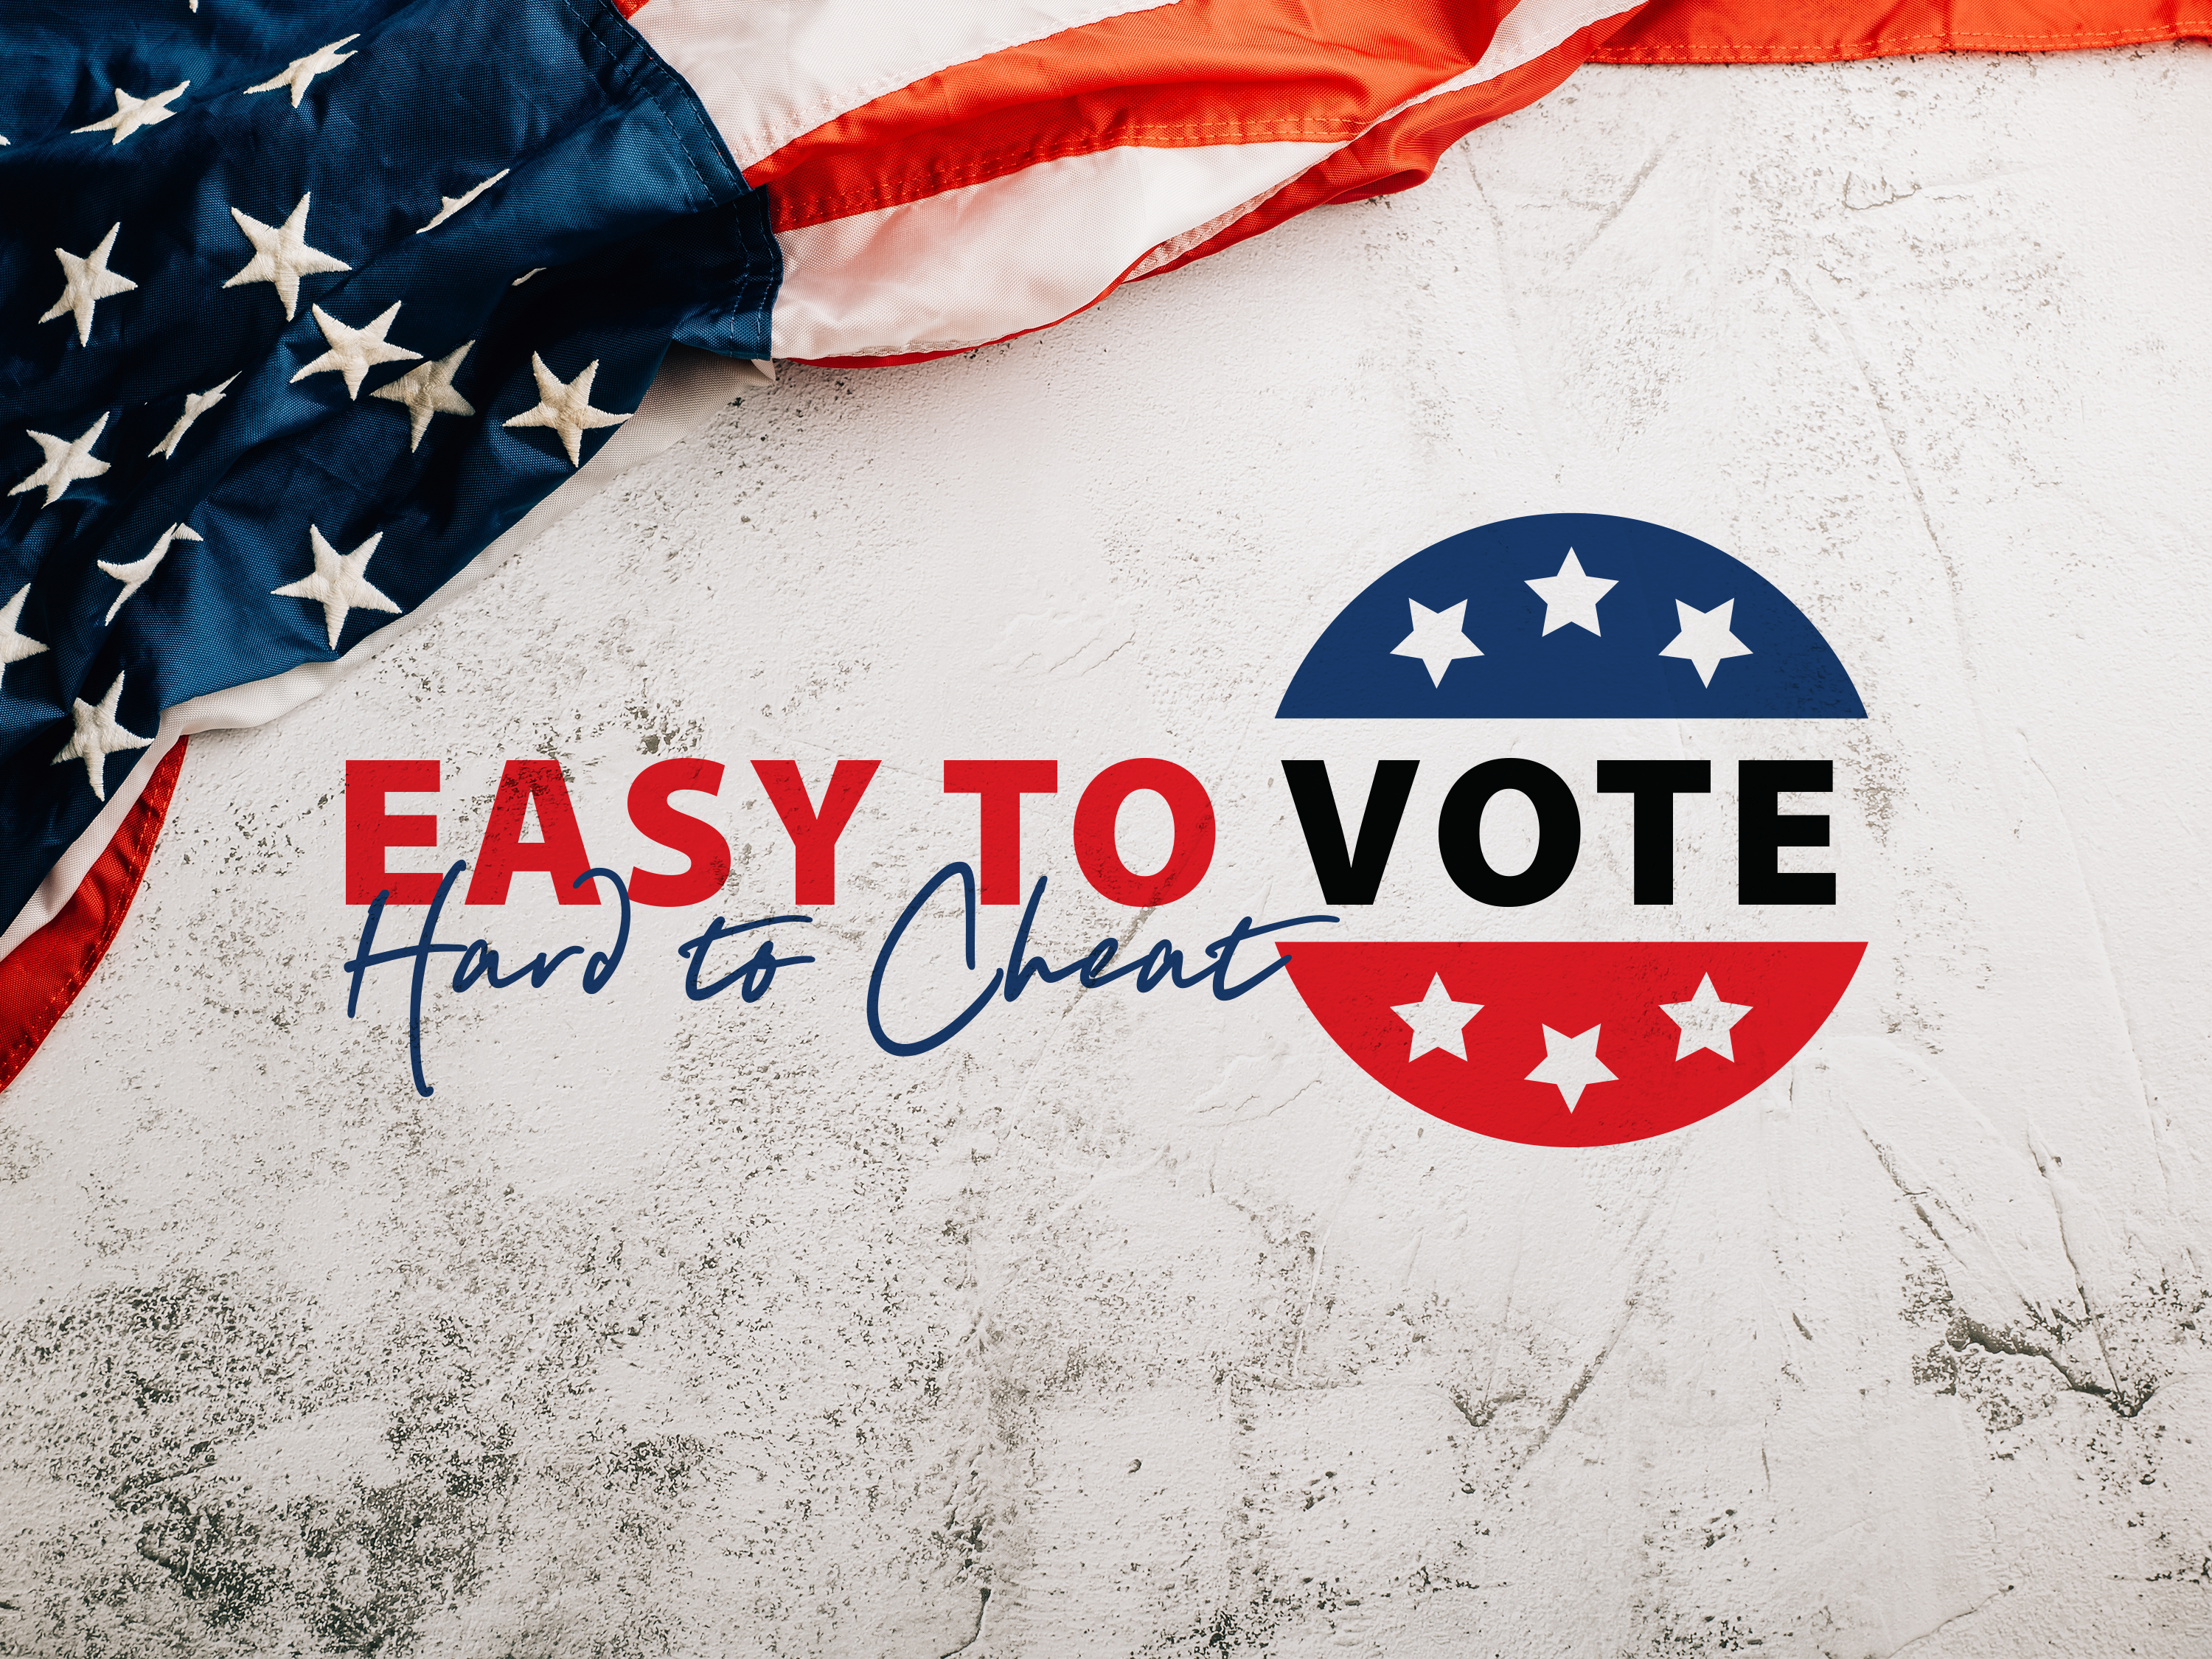
Saving America requires patriots to serve as poll workers and poll watchers to secure the 2024 election

Slide 2
OVERVIEW OF THE ISSUE
Our Founders deliberately created a decentralized election system to make it harder for a tyrant to control them. This is good!
It also means that the duty of securing our elections falls to We the People – and that means YOU have the opportunity to help!
Use this right before you lose it.
Do you care about issues like border security and mass illegal immigration? Inflation? A woke military? A weaponized federal government? Overspending and high taxes? Supreme Court nominees?
Every. Single. Issue. Depends on legitimate, honest elections.

Slide 3
POLL WORKER
The officials responsible for administering and conducting an election in the local precinct. They are usually paid, generally hired at the county level by the permanent employees who administer the elections and maintain voter rolls.
More likely to have the authority to take action if irregularities occur, though may not. Poll workers are allowed to speak inside the precinct, and that communication is the first step in solving problems.
Typical duties include: check voters into the precinct location to vote, hand the voter their ballot or card for the ballot marking device (touch screen computer with ballot), tell the voter where to deposit the ballot in the ballot box, and close the precinct location after voting is over.
Some states have different names for this role. See the Easy to Vote, Hard to Cheat guide for a list of alternative names.

Slide 4
POLL WATCHER
In the voting precinct while voters vote, silently watching and observing the election process.
Unpaid.
Have the authority to observe, but in no way interact with the voting process.
Usually, but not always, appointed and placed by the county political party.
If irregularities are observed, poll watchers will report those irregularities to the entity (i.e., the county political party) that assigned the poll watcher position in accordance with the training provided by that entity.

Slide 5
TABULATION OBSERVER
Similar to a poll watcher, but instead of watching at a polling center where citizens are voting, you are watching inside of a tabulation center.
A tabulation center or tabulation site is used by some jurisdictions as a central location to count mail-in ballots, as opposed to doing it at the precinct level.
Tabulation observers, like poll watchers, are also usually appointed by the county political parties. Note that not every state or county has tabulation centers.

Slide 6
KEY DIFFERENCE
Poll workers are more likely to have authority to take action when irregularities occur.
Poll watcher and tabulation observer do not have any authority to take action. They can only report irregularities to the entity that placed them.
However, poll watchers and tabulation observers are STILL VERY IMPORTANT.
We need as many eyes on every polling place as possible to prevent corruption!

Slide 7
HOW CAN YOU SIGN UP?
Generally speaking, if you want to be a poll worker, you will need to reach out to the county employee(s) responsible for hiring those poll workers.
To become a poll watcher or tabulation observer (if applicable), the county party of your choice will likely need to appoint you, though that is not always the se case.
The easiest way to get started with any of these positions is to fill out the form at HelpAtThePolls.com, and Tea Party Patriots Action will send you instructions for the next step to take, because the process and requirements vary from state to state and county to county. Take away the confusion by signing up!
If you think you would like to serve in any of these roles, please sign up NOW. Some states have very early deadlines!

Slide 8
OTHER THINGS TO NOTE
Sign up to serve as a poll worker, poll watcher, or tabulation observer (if applicable) with someone else, especially if you’ve never done it before. It’s always more fun to do new things with friends or family.
Think about other places you go and groups in which you are involved as potential pools of recruits. For example, school, church, sports teams, hunting buddies, etc. Think through all of the people with whom you interact and know, and whether or not they are people of integrity who care about honest elections. If they are, ask them to serve with you!
If you know any patriotic, responsible teenagers or college students and they meet the requirements to serve in your state and/or county, ask their parents if they can serve. Or, if they’re your own kids, ask them yourself!

Slide 9
To save the American experiment,
it must be Easy to Vote, but Hard to Cheat.
YOUR INVOLVEMENT IS WHAT
MAKES IT HARD TO CHEAT!

Slide 10
SO WHAT ARE YOU WAITING FOR?
HelpAtThePolls.com

