Slide 1
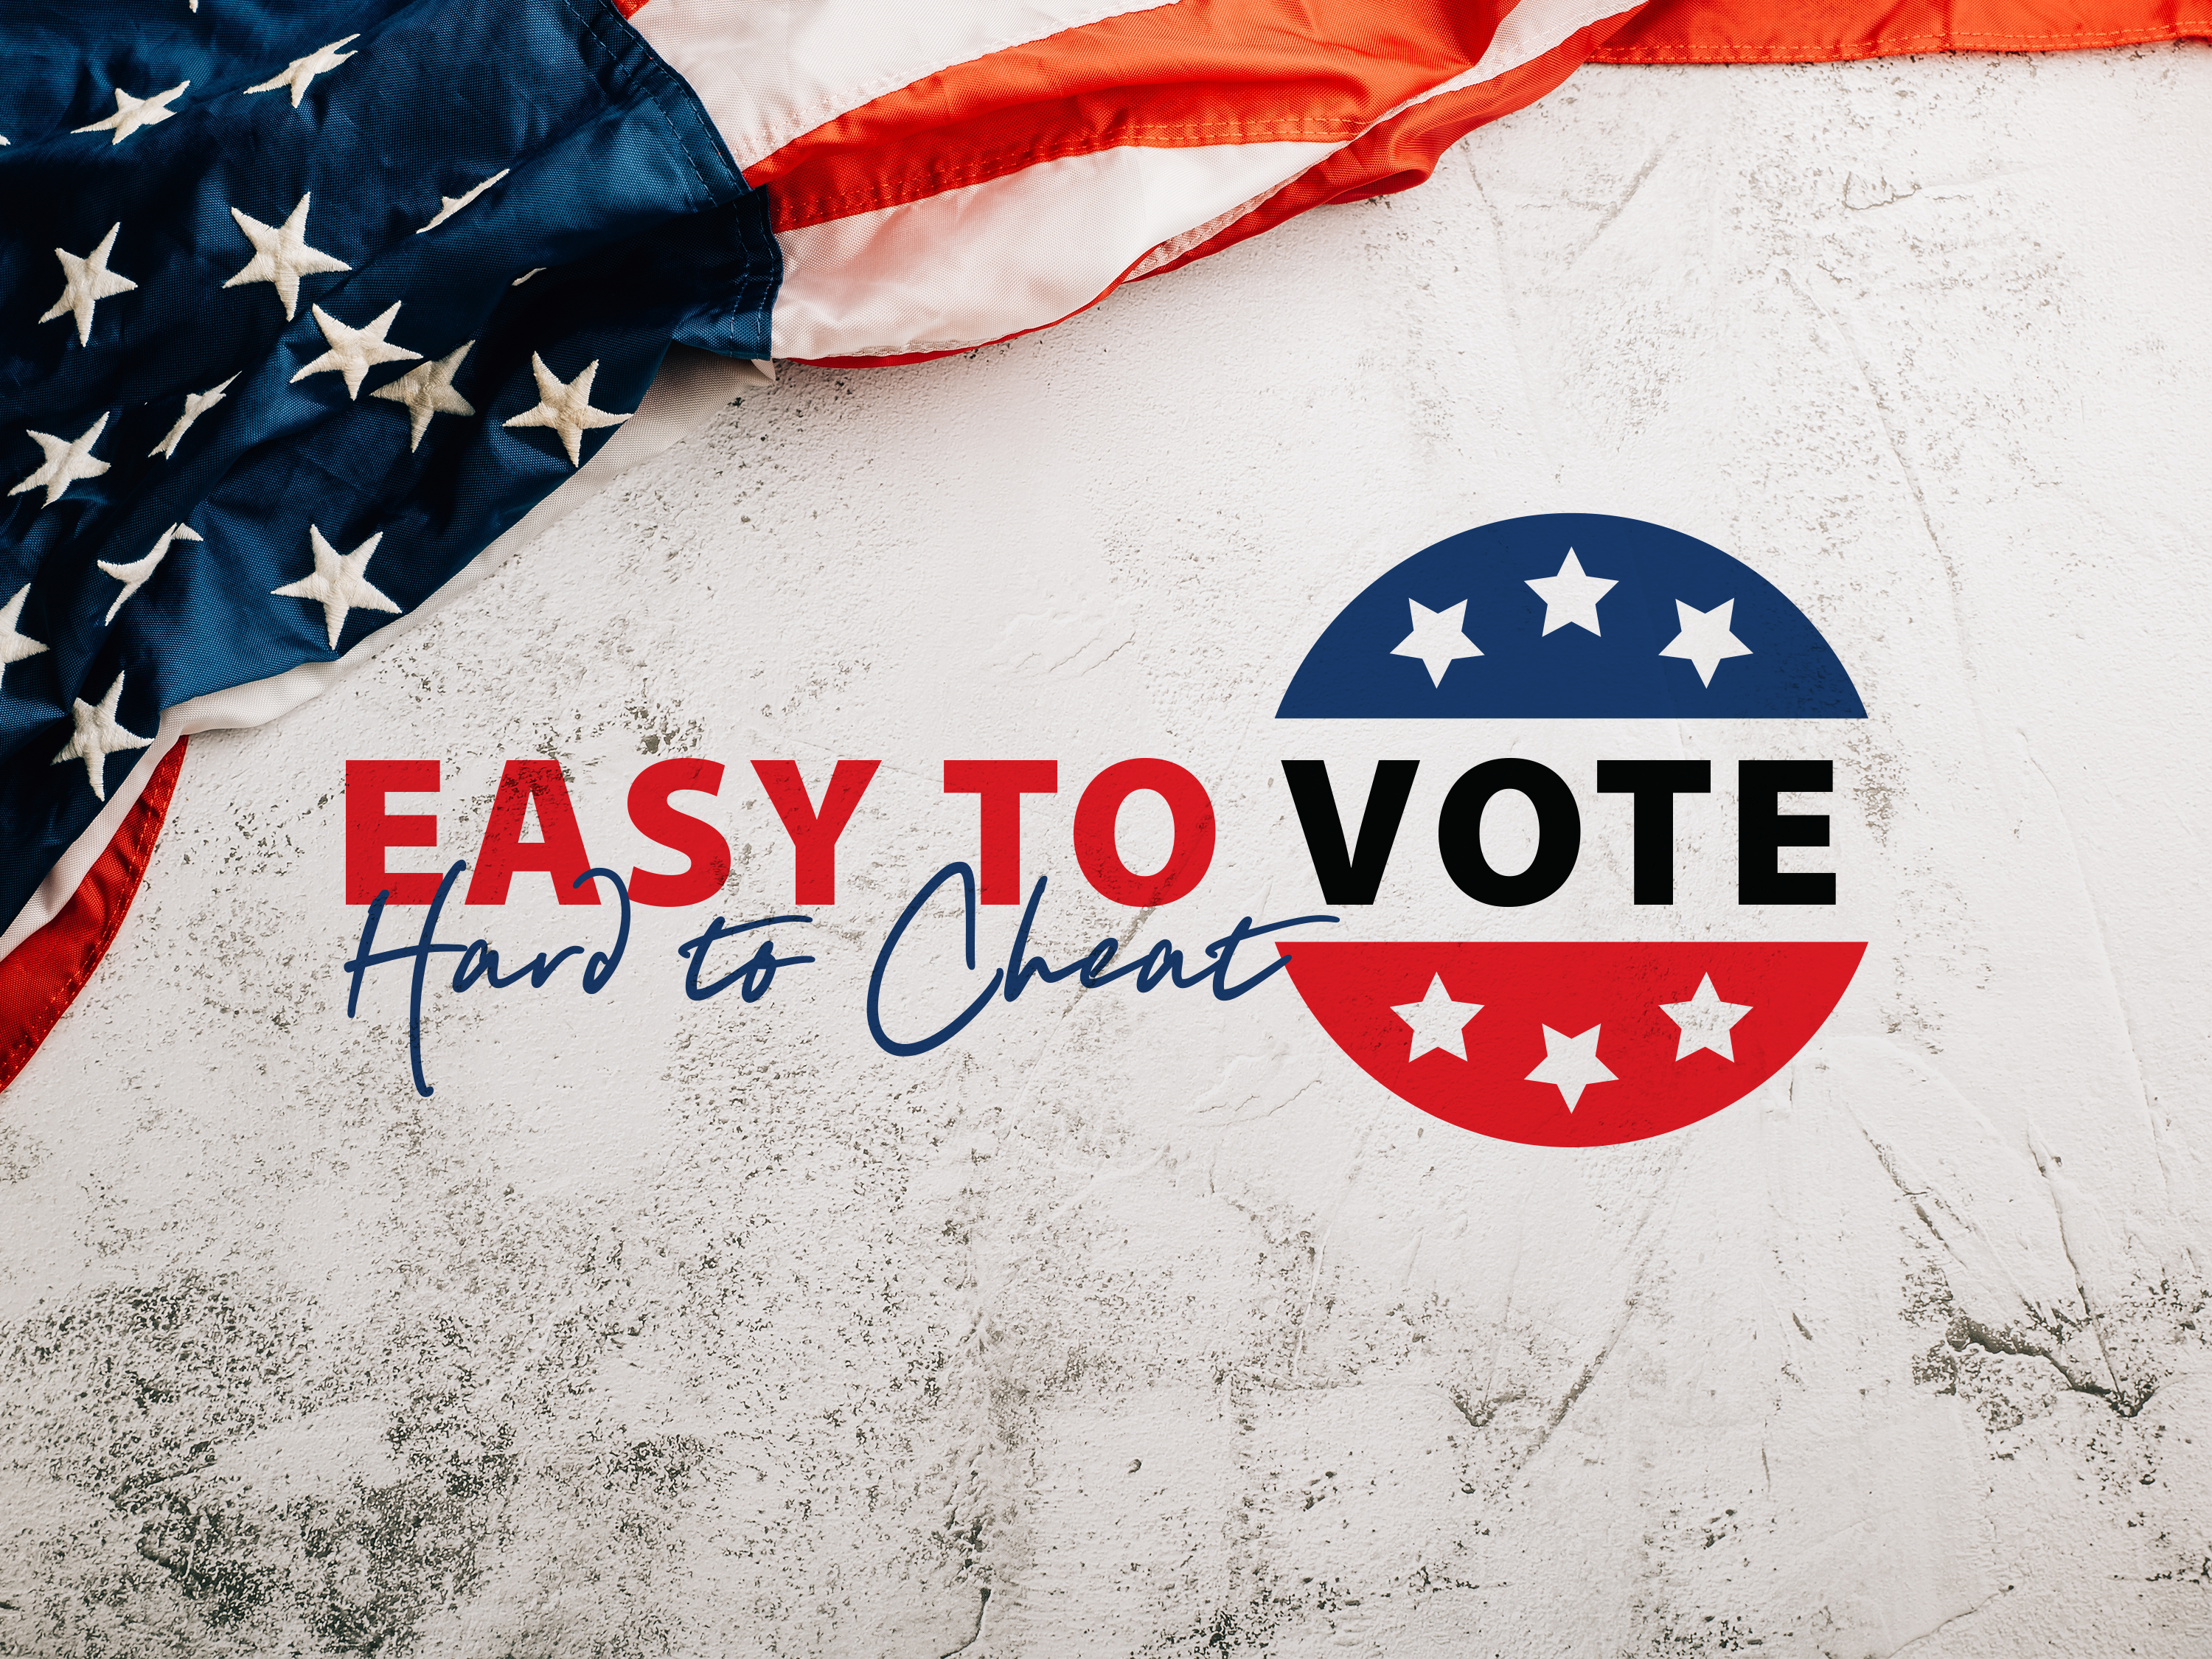
Saving America requires patriots to serve as poll workers and poll watchers to secure the 2024 election

Slide 2
OVERVIEW OF THE ISSUE
Our Founders deliberately created a decentralized election system to make it harder for a tyrant to control them.
This is VERY GOOD thing!
It also means that the duty of securing our elections falls to We the People – and that means YOU have the opportunity to help!
Use this right before you lose it.

Slide 3
OVERVIEW OF THE ISSUE
The only way to change the policies you care about is to change who creates and implements the policies.
We can’t do that if our elections are corrupt. Tyrants cannot abide by honest and fair elections because they know they will lose!
Do you care about issues like border security and mass illegal immigration? Inflation? A woke military? A weaponized federal government? Overspending and high taxes? Supreme Court nominees?
Every. Single. Issue. Depends on legitimate, honest elections.

Slide 4
OVERVIEW OF THE ISSUE
If you…
Want honest elections
Want to be able to trust election results
Want to make sure the will of the people is fulfilled
Want to have the power to change public policy
Want it to be easy to vote, but hard to cheat
Then you must get involved in election integrity efforts!!

Slide 5
HOW CAN YOU SERVE?
Sign up to be a poll worker!
Sign up to be a poll watcher!
Sign up to be a tabulation observer (if applicable)!
Post on social media to recruit other patriotic Americans – Facebook, Twitter/X, Instagram, TikTok, SnapChat, etc. See the Easy to Vote, Hard to Cheat how-to guide for sample posts.
Call in to conservative talk radio shows. See the Easy to Vote, Hard to Cheat how-to guide for a sample script.
Write an email or text to your friends/family/network encouraging them to sign up and get involved in securing our elections. See the Easy to Vote, Hard to Cheat how-to guide for samples.

Slide 6
POLL WORKER
The officials responsible for administering and conducting an election in the local precinct.
Usually paid.
More likely to have the authority to take action if irregularities occur, though may not. Poll workers are allowed to speak inside the precinct, and that communication is the first step in solving problems.
Typical duties include: check voters into the precinct location to vote, hand the voter their ballot or card for the ballot marking device (touch screen computer with ballot), tell the voter where to deposit the ballot in the ballot box, and close the precinct location after voting is over.

Slide 7
POLL WORKER
Some states have different names for poll workers. They can also be known as election official, judge of elections, inspector of elections, judge, inspector, or some other similar title.
They are generally hired at the county level by the permanent employees who administer the elections and maintain voter rolls.
The permanent employees may hold one of the following titles: election supervisor, election board, board of elections, board of commissioners, county supervisors, county judges, etc. The titles vary from state to state.

Slide 8
POLL WATCHER
In the voting precinct while voters vote, silently watching and observing the election process.
Unpaid.
Have the authority to observe, but in no way interact with the voting process.
Usually, but not always, appointed and placed by the county political party.
If irregularities are observed, poll watchers will report those irregularities to the entity (i.e., the county political party) that assigned the poll watcher position in accordance with the training provided by that entity.

Slide 9
TABULATION OBSERVER
Similar to a poll watcher, but instead of watching at a polling center where citizens are voting, you are watching inside of a tabulation center.
A tabulation center or tabulation site is used by some jurisdictions as a central location to count mail-in ballots, as opposed to doing it at the precinct level.
Tabulation observers, like poll watchers, are also usually appointed by the county political parties. Note that not every state or county has tabulation centers.

Slide 10
KEY DIFFERENCE
Poll workers are more likely to have authority to take action when irregularities occur.
Poll watcher and tabulation observer do not have any authority to take action. They can only report irregularities to the entity that placed them.
However, poll watchers and tabulation observers are STILL VERY IMPORTANT.
We need as many eyes on every polling place as possible to prevent corruption!

Slide 11
HOW CAN YOU SIGN UP?
Generally speaking, if you want to be a poll worker, you will need to reach out to the county employee(s) responsible for hiring those poll workers.
To become a poll watcher or tabulation observer (if applicable), the county party of your choice will likely need to appoint you, though that is not the case 100% of the time.
The easiest way to get started with any of these positions is to fill out the form at HelpAtThePolls.com, and Tea Party Patriots Action will send you instructions for the next step to take, because the process and requirements vary from state to state and county to county. Take away the confusion by signing up!

Slide 12
IMPORTANT NOTE
If you think you would like to serve in any of these roles, please sign up NOW.
Because many states and counties have a particular process that must be used, it takes a while to get it all done, and there is usually a deadline by which the workers and watchers must be chosen.

Slide 13
OTHER THINGS TO NOTE
Sign up to serve as a poll worker, poll watcher, or tabulation observer (if applicable) with someone else, especially if you’ve never done it before. It’s always more fun to do new things with friends or family.
Think about other places you go and groups in which you are involved as potential pools of recruits. For example, school, church, sports teams, hunting buddies, etc. Think through all of the people with whom you interact and know, and whether or not they are people of integrity who care about honest elections. If they are, ask them to serve with you!
If you know any patriotic, responsible teenagers or college students and they meet the requirements to serve in your state and/or county, ask their parents if they can serve. Or, if they’re your own kids, ask them yourself!

Slide 14
REMEMBER…
Don’t look at the necessity for us to be involved in election integrity as a burden.
Understand it as the blessing that it is! Appreciate that our Founders built it this way. They understood that everyday Americans would need to be involved civically in many different ways to keep our republic.
Securing our elections is one of the ways we secure our liberty.

Slide 15
To save the American experiment,
it must be Easy to Vote, but Hard to Cheat.
YOUR INVOLVEMENT IS WHAT
MAKES IT HARD TO CHEAT!

Slide 16
SO WHAT ARE YOU WAITING FOR?
HelpAtThePolls.com

