Slide 1
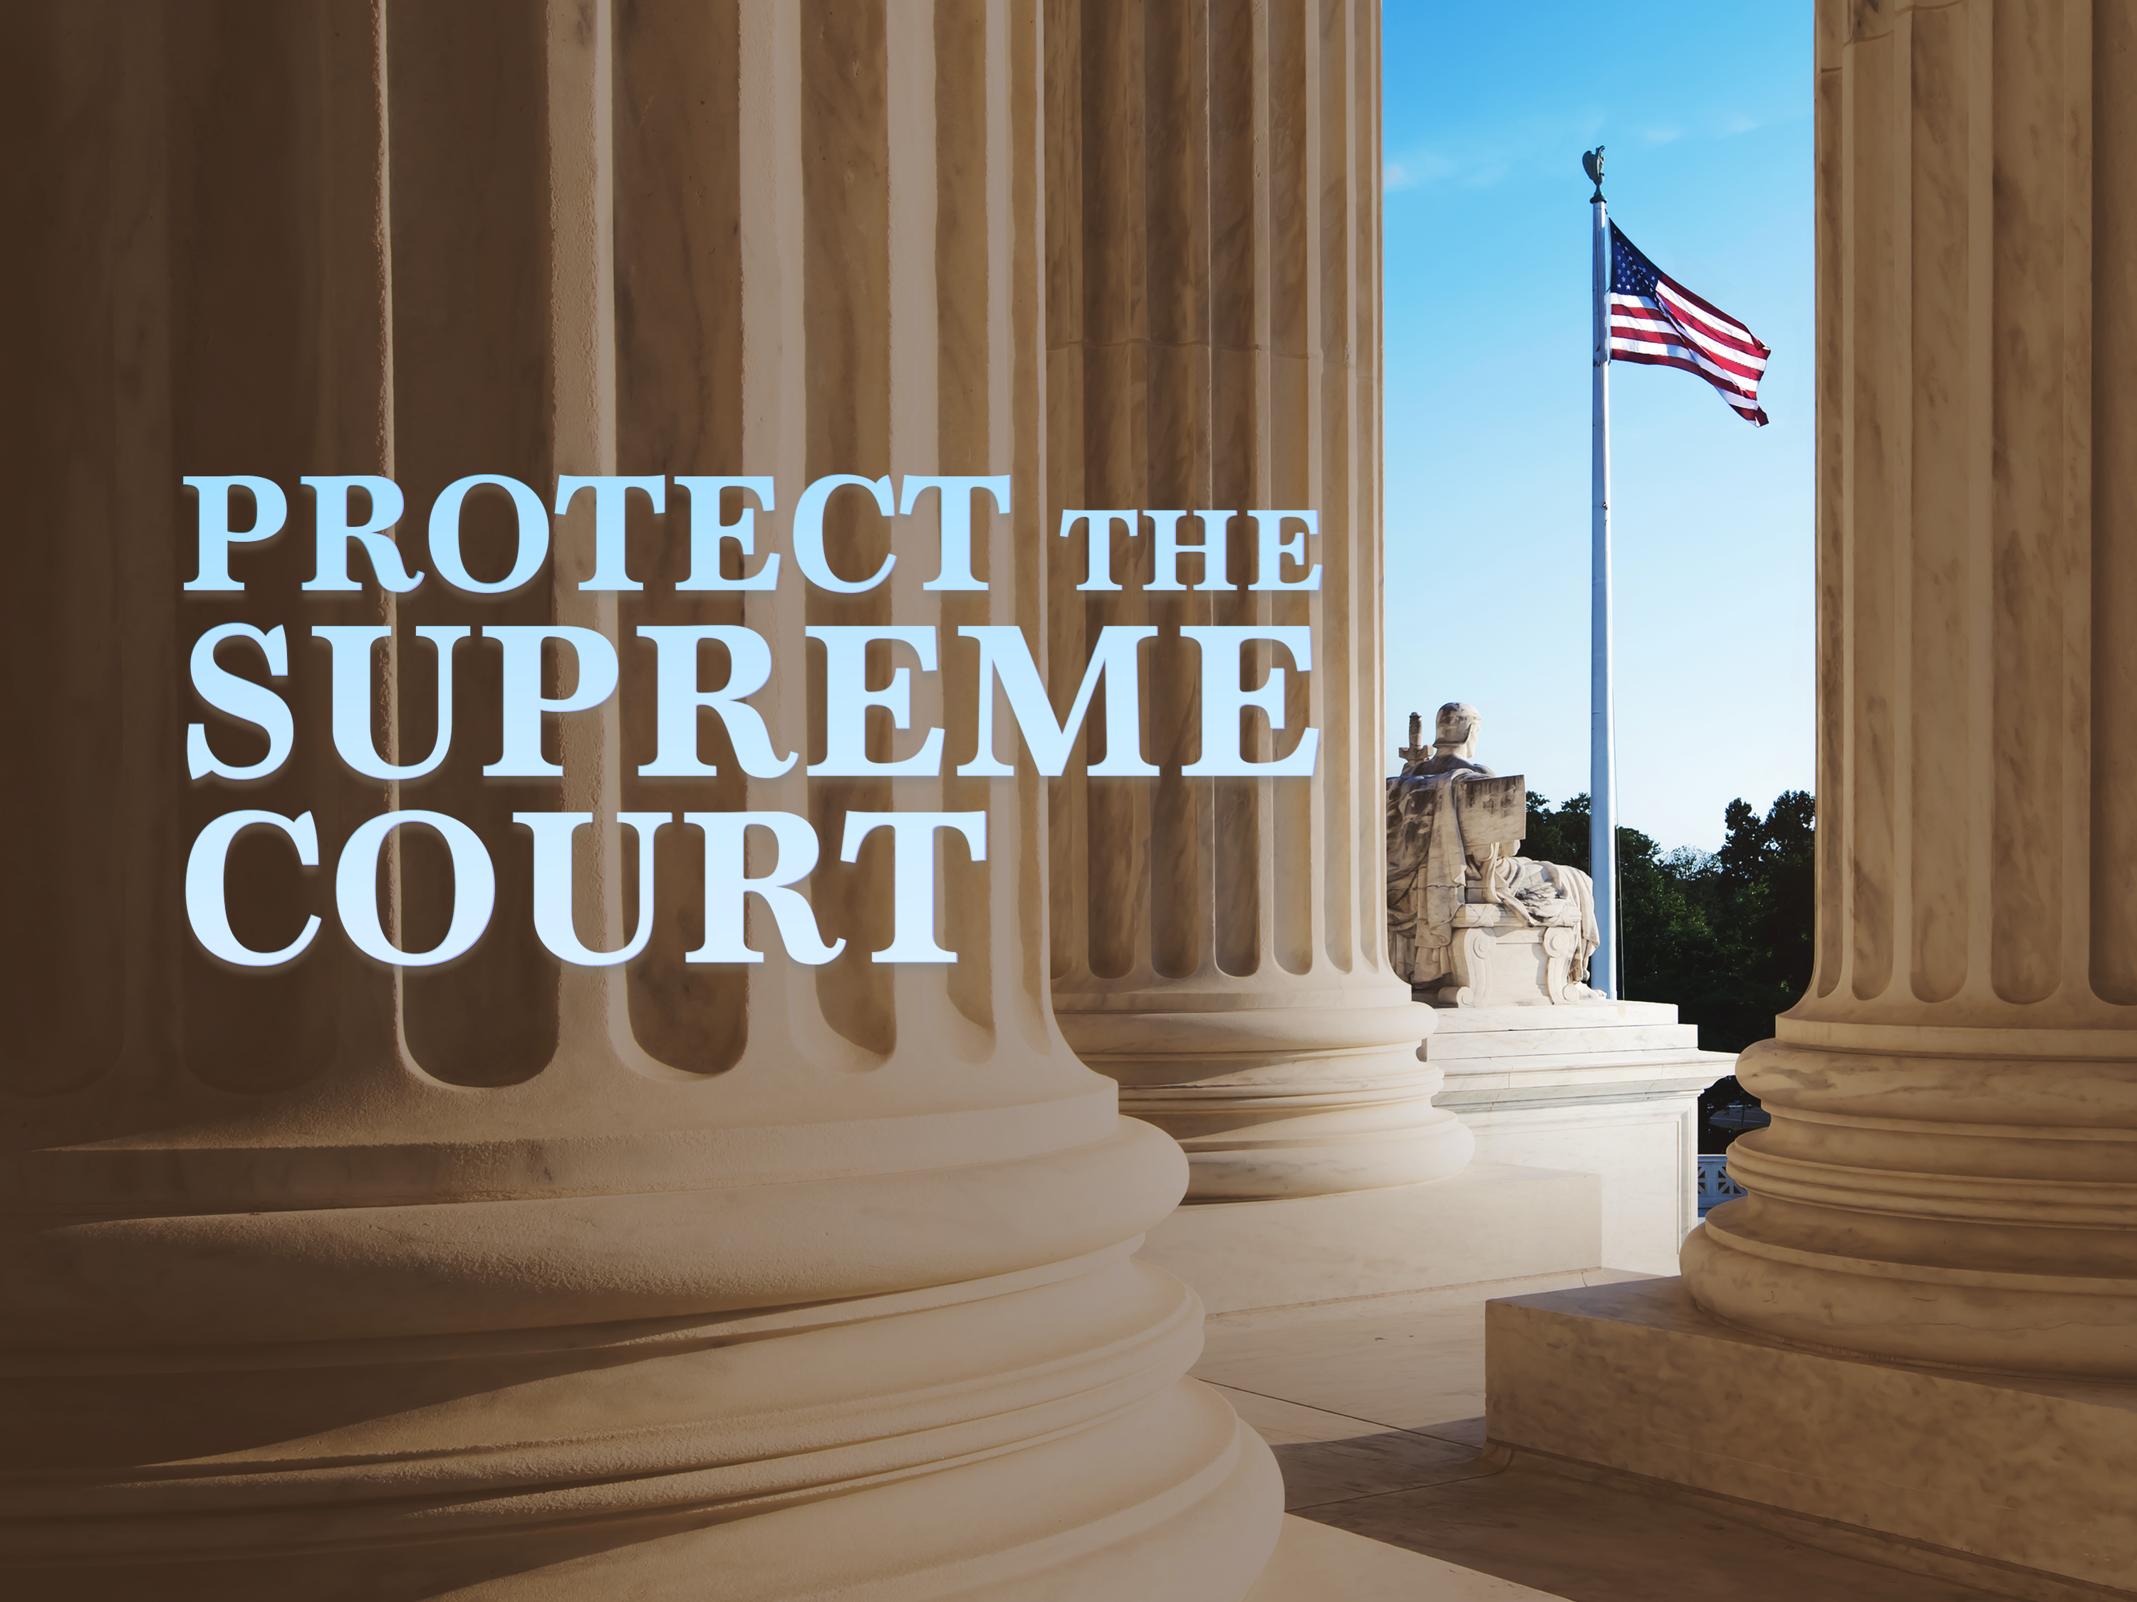
Defending the Integrity of the Court
25-30 Minutes

Slide 2
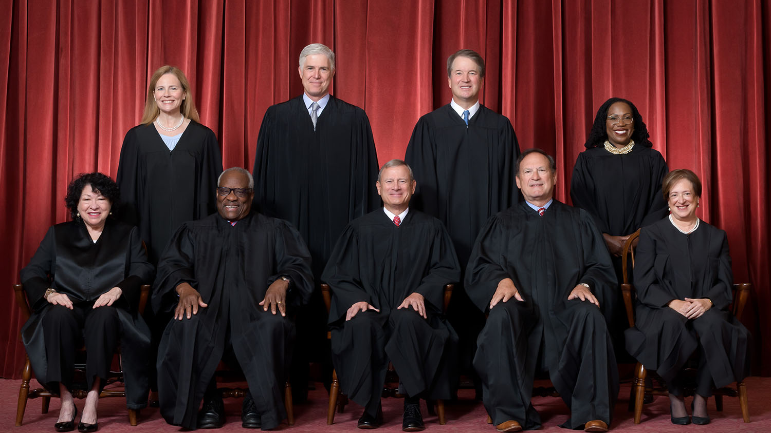
Notes:
There is a relentless effort by American progressives to remove Justice Clarence Thomas from the Supreme Court, cast doubt on other justices, and to further undermine the integrity of the Court by adding several justices (also known as “court packing”).
The left is furious they no longer control the Supreme Court. For decades, no matter if it was a Republican or Democrat President, the appointees to the Court were liberals. And the court often acted as a super legislature implementing left wing policies, like a constitutional right to abortion.
They want it to go back to the way it was - having power and control over our nation, and they can’t achieve this while the Supreme Court remains independent.
Therefore, they must corrupt the Court so that it is nothing more than a rubber stamp for radical, left-wing policies.
This presentation will cover both efforts, so that you are able to refute the lies and take effective action to stop them.

Slide 3
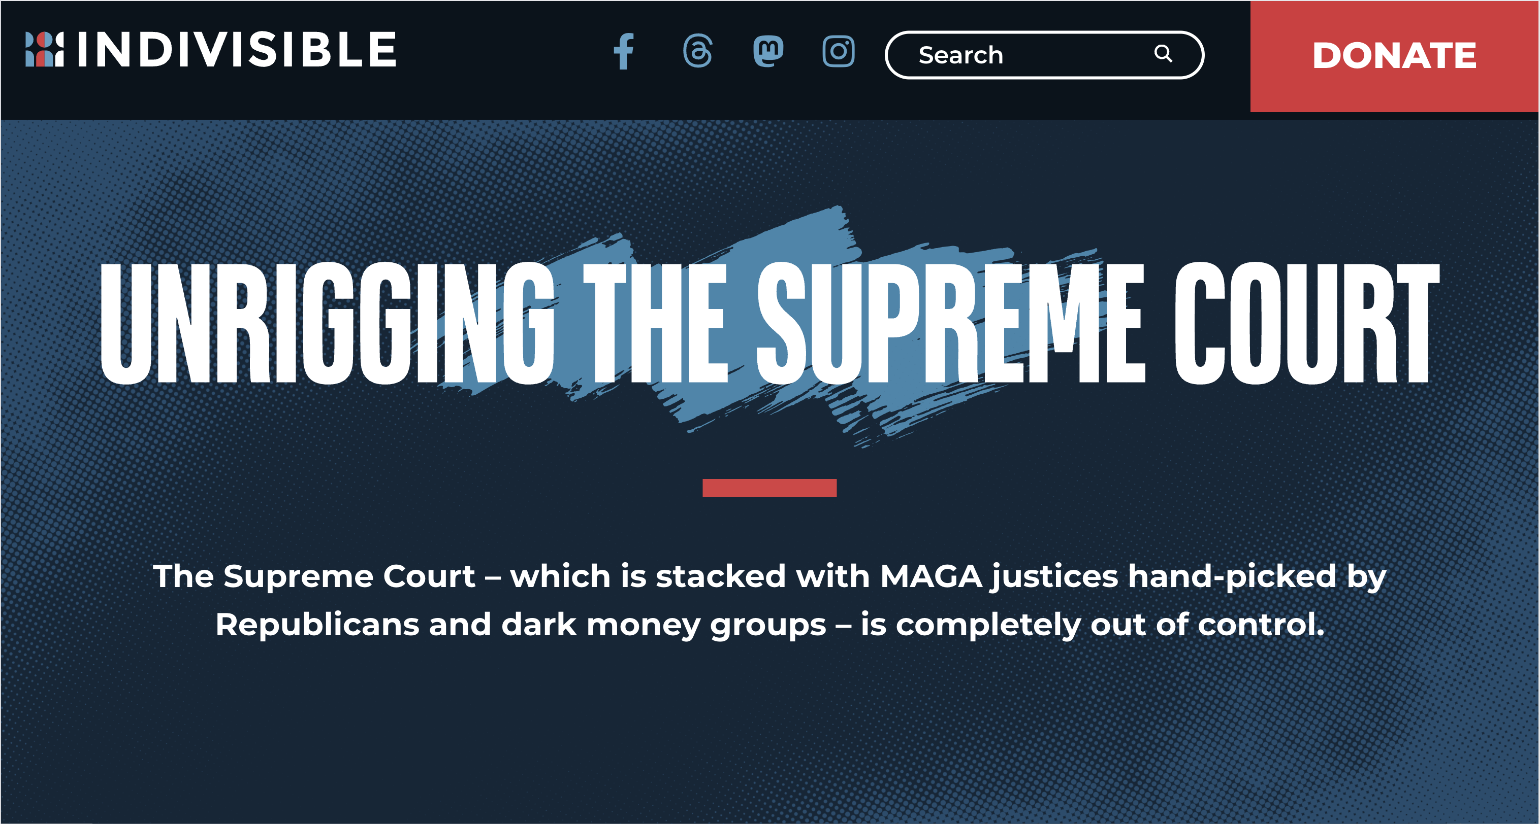
Why now?
You must be ready to protect the Supreme Court as a whole and specific justices when these decisions are announced.
Notes:
Why is it important to learn about this topic now?
There are several extremely important cases that our Supreme Court will issue opinions on this year, one of which is the presidential immunity case that will affect President Trump.If the decisions on these cases do not go the way the left wants, they will lose their minds. Think “summer of 2020” kind of violence in the streets.
They will also take to the airwaves, social media, and person-to-person to spread their lies and attacks.
In fact, the image you’re looking at is taken from a left-wing group that launched after Donald Trump won in 2016 called “Indivisible.” They are dedicated to defeating him in November this year, and one of their tactics to win in November involves attacking and discrediting the Supreme Court. They believe that they can turn out more liberal voters with lies about a “rigged” and “illegitimate” Court, and it could be the deciding factor in the 2024 election.
This is why you must be ready to protect the Supreme Court as a whole and specific justices when these decisions are announced, as well as in the lead up to the November election. Some people may think the Supreme Court is not an election issue - Indivisible certainly hopes our side feels this way - but it absolutely is an issue we should be talking about, sharing the truth, and defending the justices and the Court as a whole.

Slide 4
The Left’s Plan
1. Attack, discredit, and impeach.
2. Manipulate to pack the Supreme Court.
Notes:
The Left’s Plan
The plan in 2 simple steps:
Attack, discredit, and finally impeach any justice who doesn’t fall in line with the liberal agenda. Sowing doubt about the justices creates doubt about the decisions they make. And as Americans lose confidence in the Court, they are more open to “solutions” offered by the left.
Manipulate Americans into thinking that the only way the Supreme Court can be unbiased and fair is by adding 4 extra justices – but only when there is a Democrat Senate and Democrat President to do the adding… of course. (Adding extra Justices to the Court is known as “Packing the court.”)

Slide 5
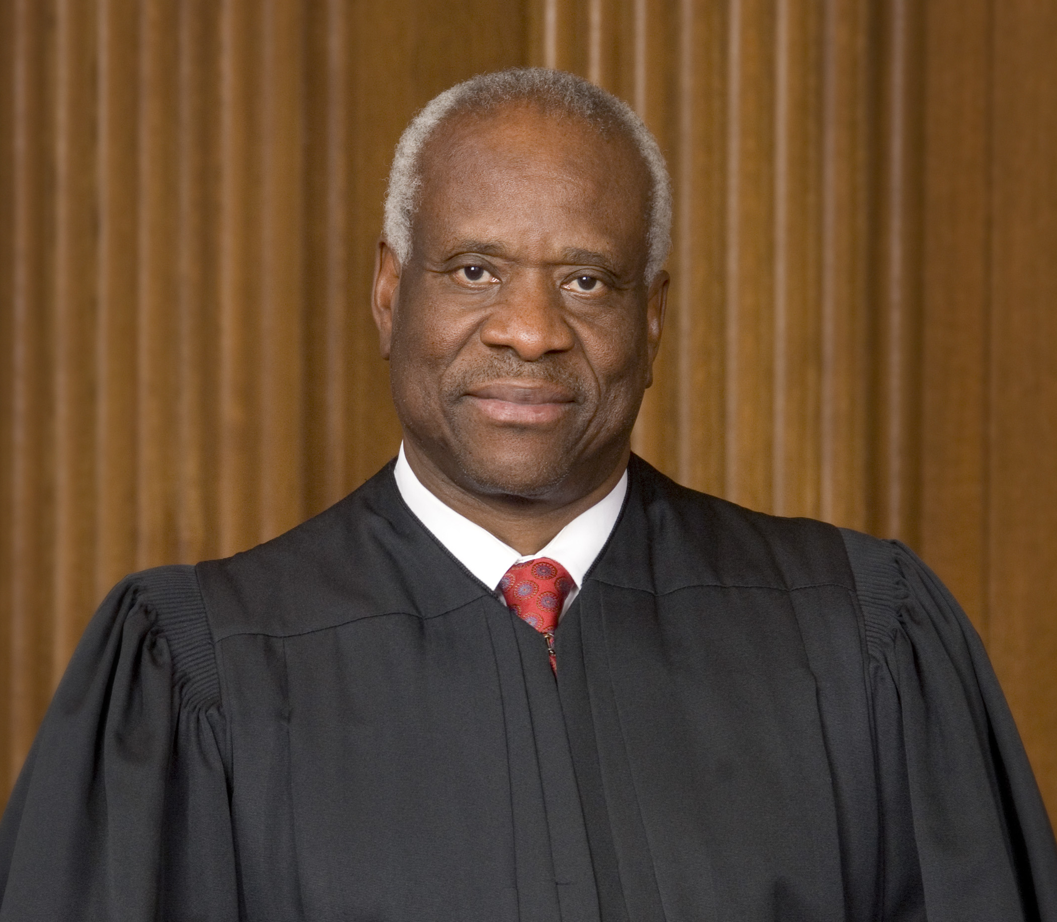
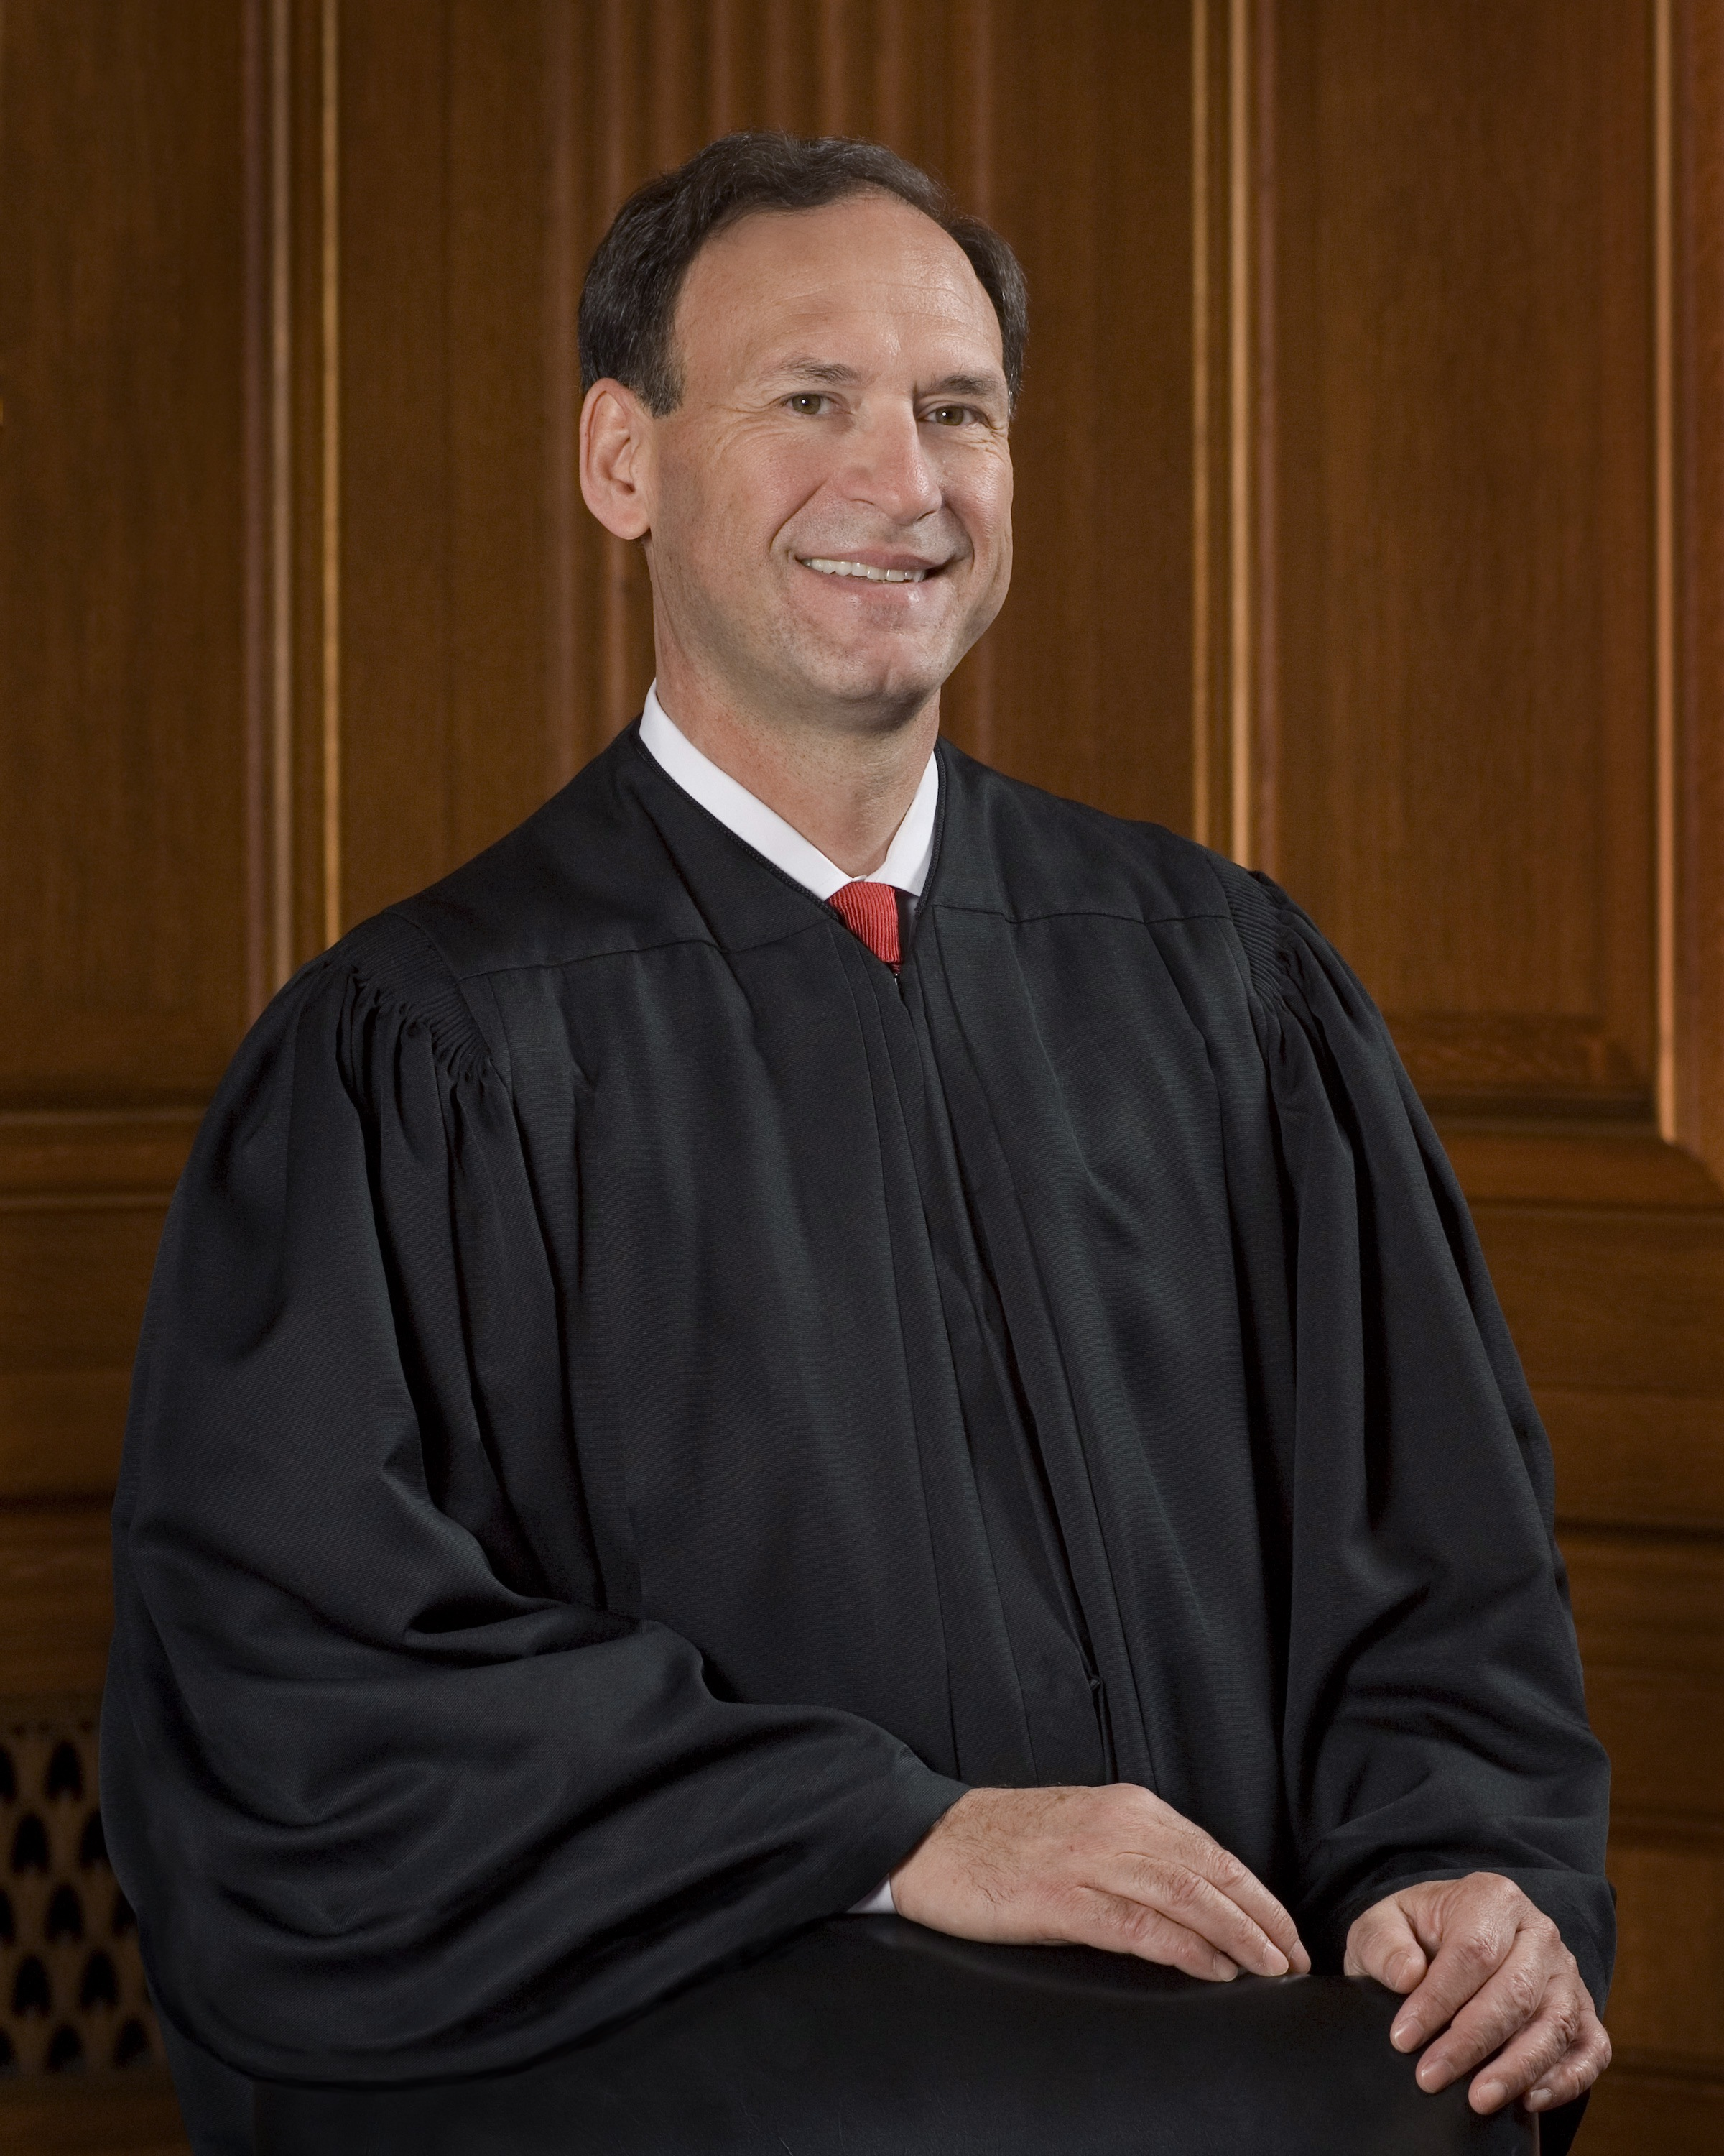
Stand up for Justice Clarence Thomas
(and others)
Notes:
Let’s tackle point #1 first.

Slide 6
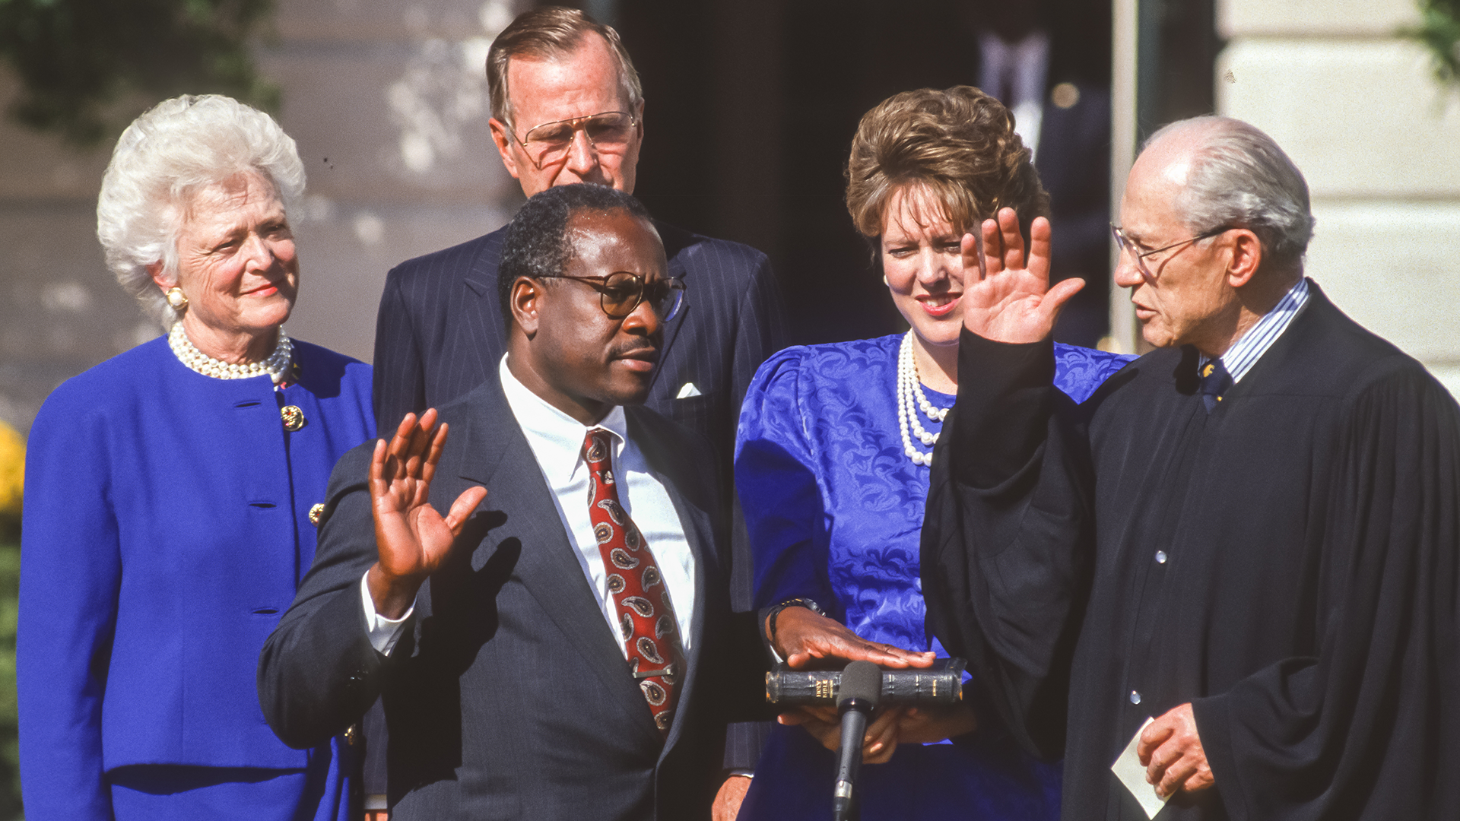
Notes:
Supreme Court Justice Clarence Thomas was sworn into office in October 1991 and has been a target of the Democrats from the moment his nomination was announced.
Since then, the left has been laser-focused on destroying Justice Thomas and his family. They use insidious lies and the power they have through the mainstream media as their weapons of attack.
The leftist media and other prominent liberal figures would have Americans believe Justice Thomas is an inept, biased judge who is incapable of making a fair assessment in any case.
However, that couldn’t be further from the truth.

Slide 7
Lies vs Truth
Notes:
The Left is lying about Justice Thomas in an effort to attack, discredit, and impeach him. Whether they impeach or not, they hope that, at the very least, they will discredit him enough to cast a shadow over every decision he makes, destroying confidence in the Court overall.
Here are some of the biggest lies they are currently telling.

Slide 8

Lie #1: Ethics Violations
Notes:
The first lie is that conservative justices - and only conservative justices - are engaged in constant ethics violations. For instance, liberals are saying that Justice Thomas did not disclose vacations with billionaire friend Harlan Crow, and that he violated Supreme Court ethics by not disclosing the vacations.

Slide 9
The Truth
Under rules in place at the time, vacations with friends were exempt from reporting under the personal hospitality exceptions set forth in the rules.
Justice Thomas has complied with the rules, but has been subjected to an unprecedented smear campaign for not bowing to these attacks.
Notes:
THE TRUTH
Under rules in place at the time, vacations with friends were exempt from reporting under the personal hospitality exceptions set forth in the rules.
In 2012, after left wing groups and 20 Democrat Members of Congress filed a complaint alleging that Justice Thomas had improperly not disclosed his trips with Harlan Crow, the Judicial Conference of the United States, which is comprised of federal judges and is charged by law with implementing and enforcing the ethics law for the federal judiciary, ruled that Justice Thomas had not failed to disclose any required information on his disclosure forms regarding his trips.
Justice Thomas has complied with the rules, but has been subjected to an unprecedented smear campaign for not bowing to these attacks - for years! Even though this lie was debunked YEARS AGO, the left keeps repeating it.
While the Supreme Court already followed ethics guidelines, to address the non-stop attacks, the Court issued a “Code of Ethics” last year. Not surprisingly, justices who disagree with the left are the only targets of “ethics” attacks.
The attacks against Justice Thomas have ranged from railing against who he vacationed with, who his friends are, and speaking engagements he accepted - none of which violated any law or code of conduct.
Let me repeat: None of his actions violated any law or code of conduct!
Sadly, this is just one of the attacks against one of the greatest Supreme Court justices we’ve ever had, and is one small piece in a larger agenda to destroy an independent Supreme Court.

Slide 10
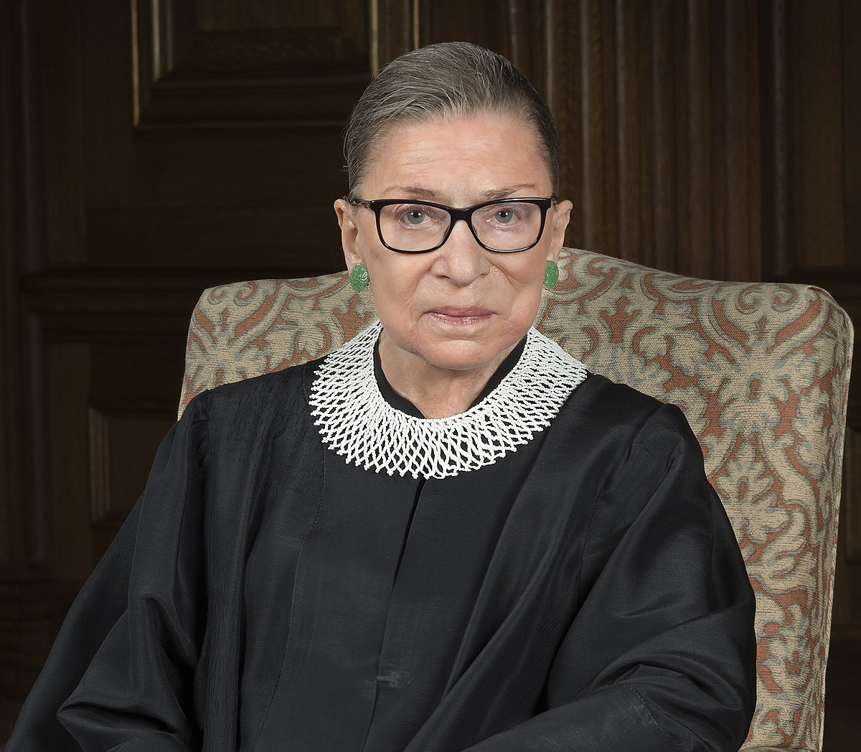


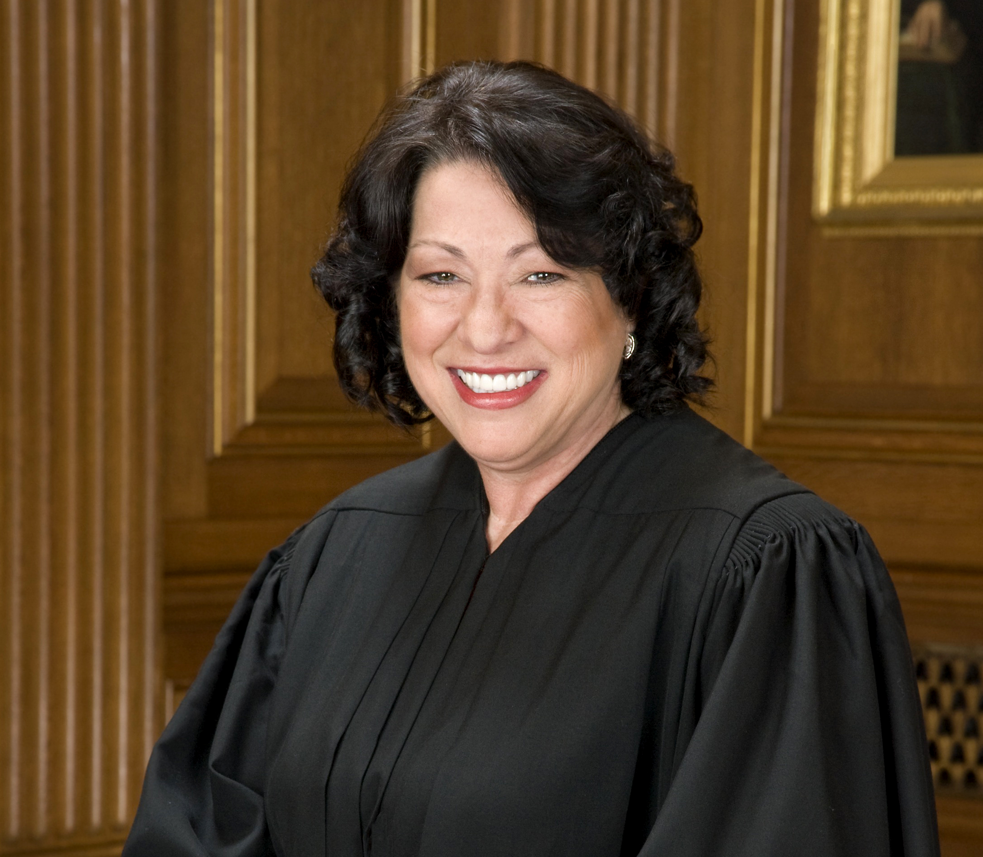
Notes:
Furthermore, the left is engaging in a coordinated effort to attack many of the conservative justices on invented “ethics” issues. Justices Alito, Gorsuch, Barrett, Kavanaugh, and even Chief Justice Roberts have all been smeared with phony attacks, and yet the mainstream press amplifies as if they are real.
The Democrats and allies in the media don’t care about ethics. They gave Justice Ruth Bader Ginsburg a pass for many ethical violations, including accepting an award from a partisan Democrat club and donating an autographed opinion for a fundraiser for the pro-abortion group NOW. No one demanded she recuse herself from abortion-related cases.
Justice Sonya Sotomayor acts as the officiant for same sex unions. Again, no one has ever demanded that she recuse herself from related cases.

Slide 11
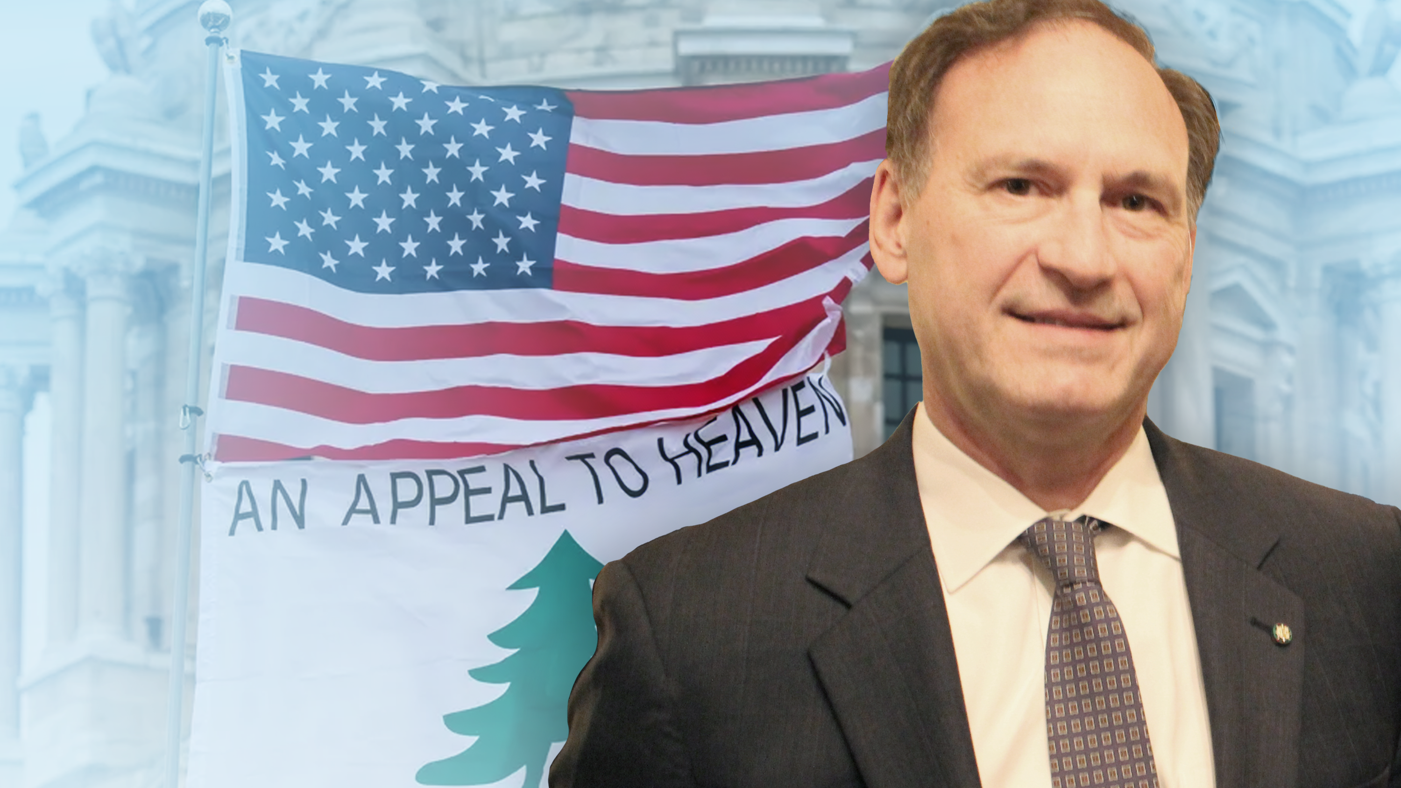
Notes:
Another example of the “Ethics Violations” attacks are the most recent attacks on Justice Samuel Alito.
The left is now attacking Justice Alito over two flags.
First, in 2021, an upside down American flag was flown at Justice Alito’s home in Virginia. His wife flew the upside down flag in response to a neighborhood spat.
Then, in 2023, the “Appeal to Heaven” flag flew at his vacation home. This flag is part of American history, and was a rallying cry for our troops during the Revolutionary War. There is nothing unethical about, or wrong with this flag.
The left is trying to use these two flags as evidence that Justice Alito has an ethical obligation to recuse himself from any cases having to do with President Trump or January 6th.
This is beyond absurd. It is deceitful and malevolent. It is the work of people who do not want fairness or justice, but instead who want control and power. Understand the premeditated narrative that is being carefully constructed about these flags. It is not an accident that every mainstream media outlet is trying to tie Justice Alito and these two flags to January 6th!

Slide 12
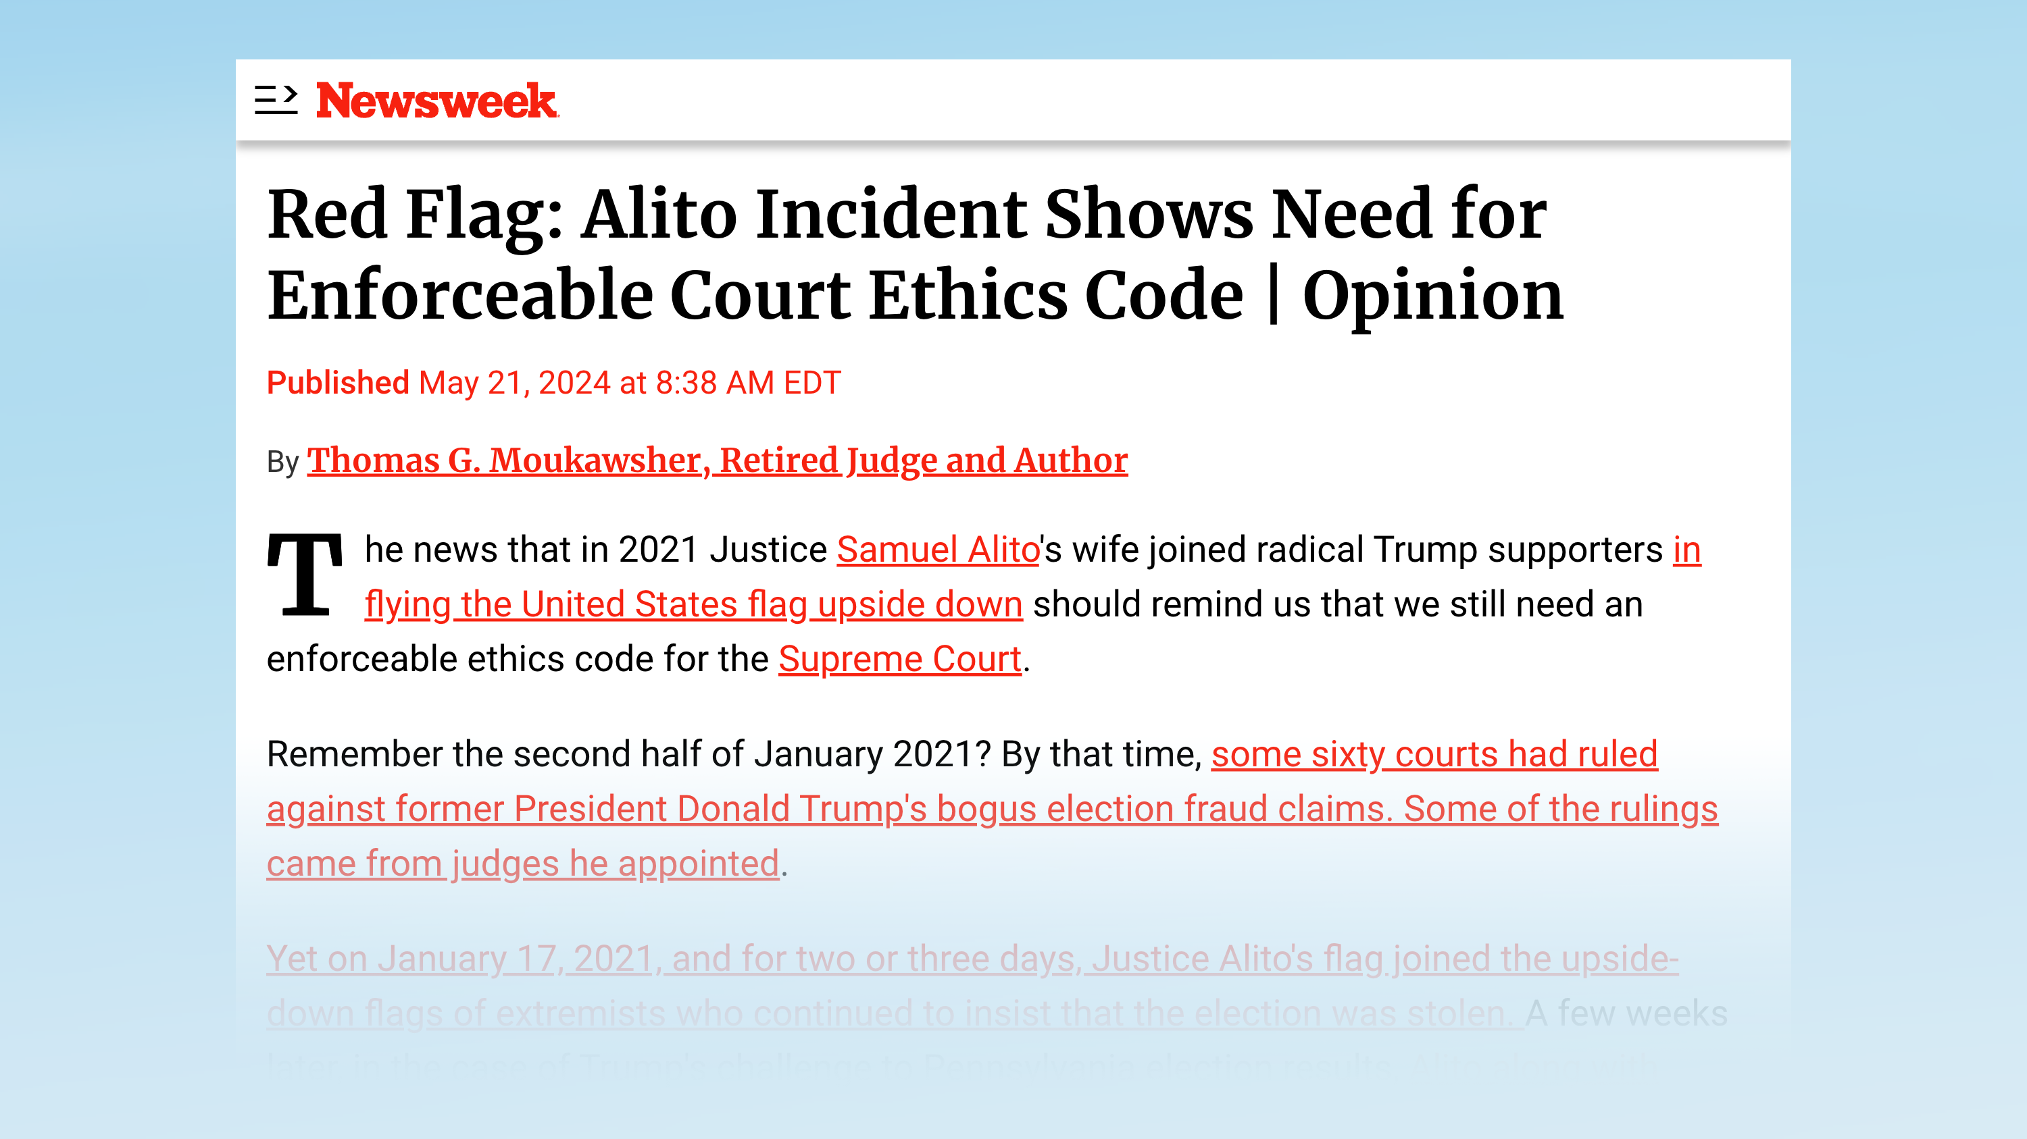
Notes:
And, again, these attacks are not happening in a vacuum.
For example, on May 21, 2024, Newsweek published an article demanding that the Supreme Court adopt an ethics code that would be enforced by an ethics commission, no doubt staffed by leftists. The consequences for “violating the ethics code” would be recusal and possibly other penalties.
The author is clearly upset that Justices Thomas and Alito will be able to help decide cases that affect President Trump.
But it’s not just about one case. Multiple and long-term political goals of the left are served by attacking individual justices in this way.

Slide 13
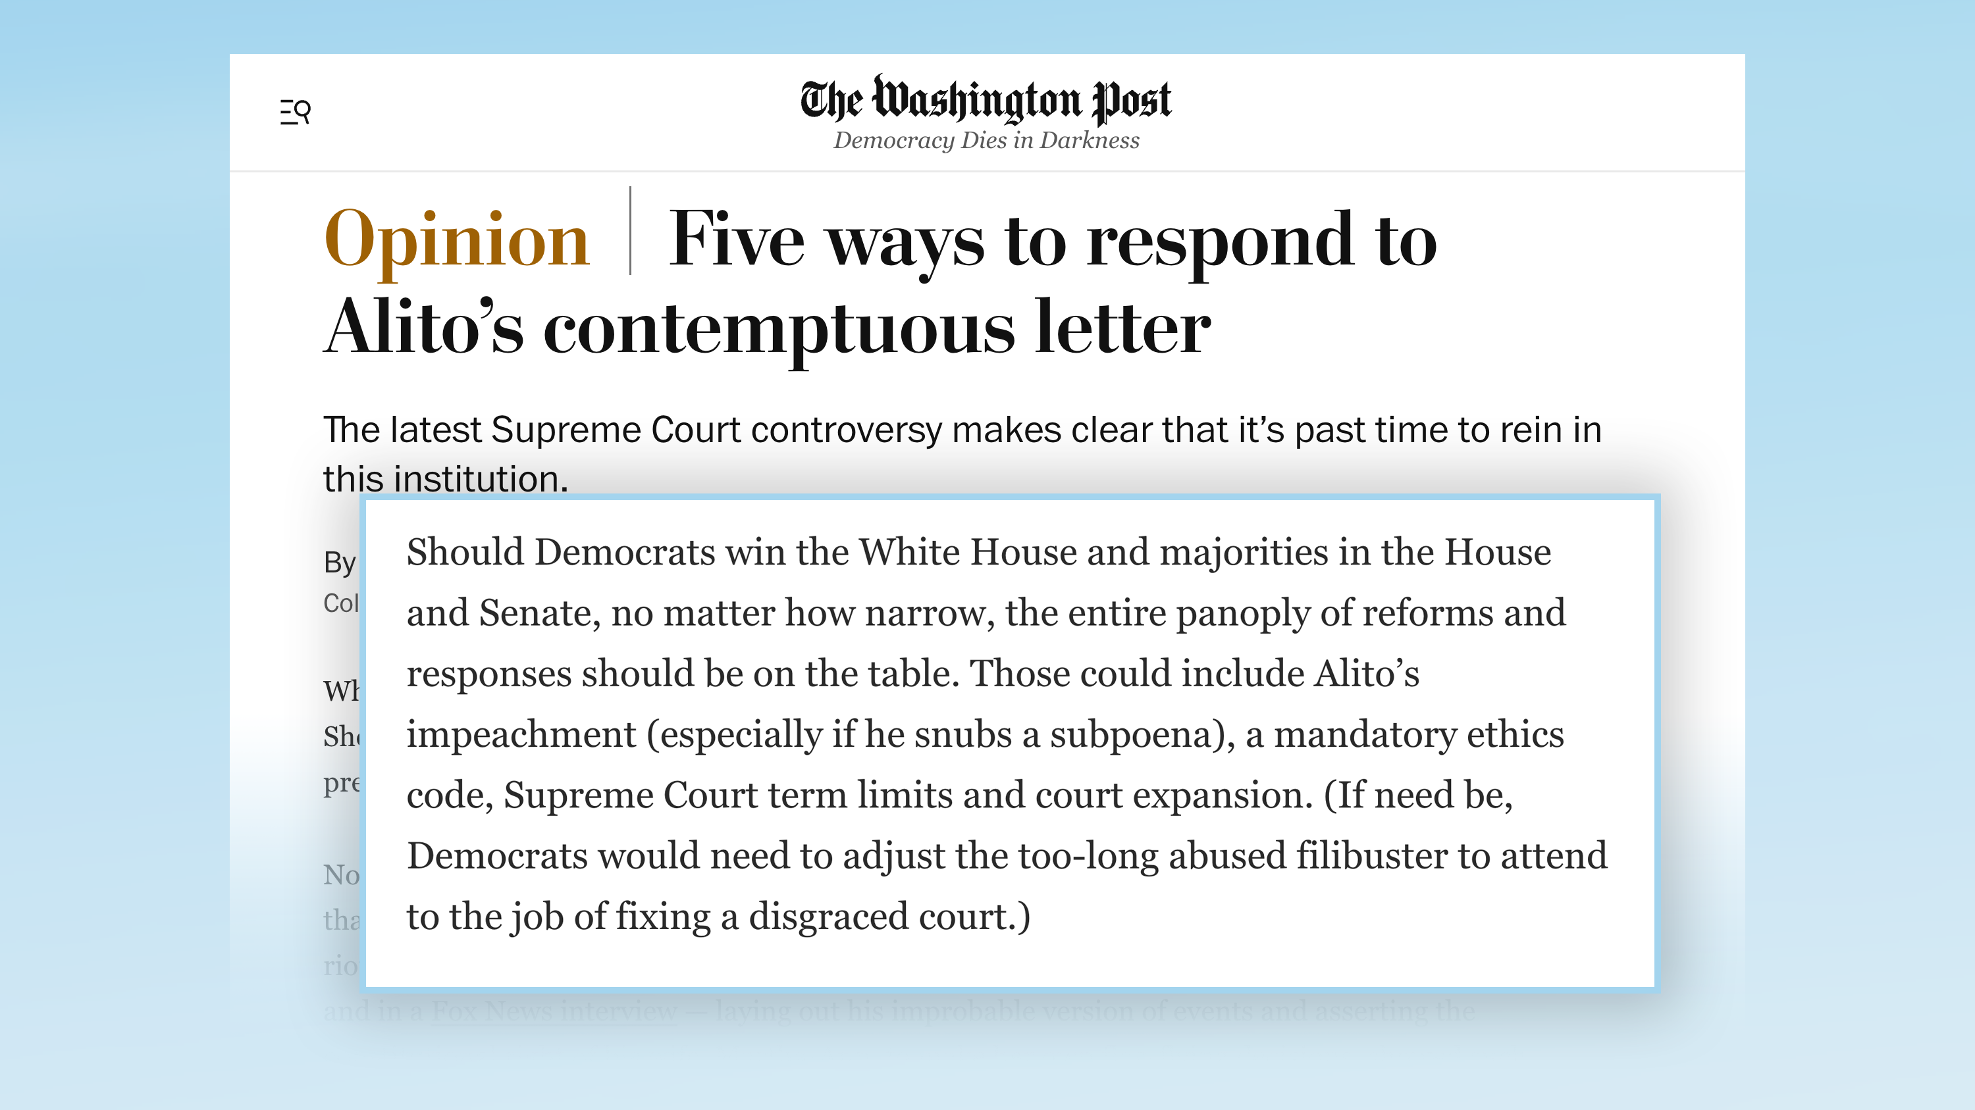
Notes:
Article after article by liberals conveniently suggest that all these “scandals” are damaging the Court’s legitimacy, and that Americans are losing trust in the Supreme Court.
But these are all manufactured “scandals,” created by leftists, targeting only the justices they want removed. They aren’t reporting news about existing public opinion. They are using news media outlets to SHAPE public opinion, hoping to foster a crisis of confidence so deep that the American people side with leftists on recusals, impeachment, and packing the court.

Slide 14
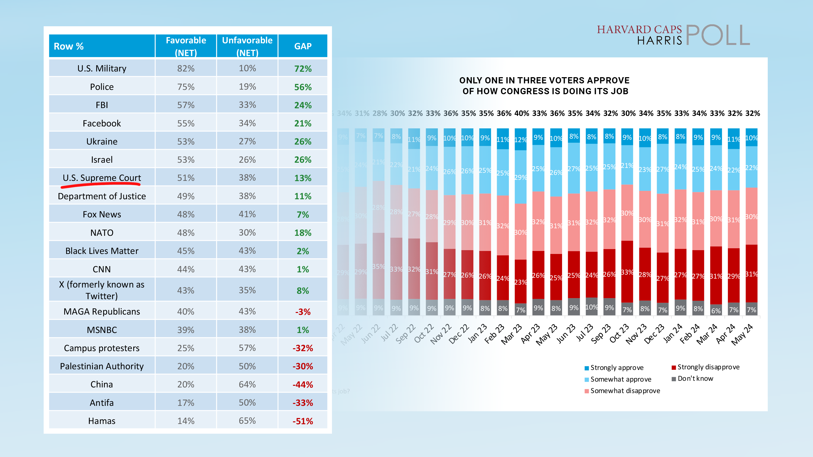
Notes:
In fact, let’s look at recent polling about the Court.
As members of Congress and political commentators question the ethical behavior of certain Supreme Court justices, and make the claim that the American people don’t trust the Court anymore, it is important to understand the actual opinion of the people.
A poll fielded May 15-16, 2024, shows that the Supreme Court holds a 52% approval rating among Americans, which is in line with polling for the Supreme Court for decades. In contrast, Congress’ approval rating is only 32%. The Supreme Court also holds a higher approval rating than Fox News, CNN, or MSNBC.
And, what about the Washington Post? That’s the paper where that quote in a previous slide was pulled from, about how Justice Alito needs to be impeached and the Court must be expanded to “fix a disgraced court.” According to a Reuter's Institute survey in June of 2021, the Washington Post had a lower approval rating than the Supreme Court.
Remember this when members of Congress or the media attack the Supreme Court and express “concern” about the public’s opinion of the Court, and claim that drastic measures must be taken to “fix” the Court’s credibility. None of these people or institutions have a higher rating than the Court.
[Polling sources: May poll, WaPo poll]

Slide 15
Simply put: The left doesn’t care about ethics.
They care about winning specific cases and destroying the independence of the Supreme Court in order to control the United States.
Notes:
Simply put: The left doesn’t care about ethics. They care about winning specific cases and destroying the independence of the Supreme Court in order to control the United States.

Slide 16
Lie #2: Insurrectionist
Notes:
The second lie that the left is pushing is about Clarence Thomas’ wife Ginni Thomas. They claim Ginni was involved in so-called “election denying” in 2020 and so-called “insurrection” on January 6, 2021, and that this makes her husband unfit to decide certain cases.
Note that “election denying” and “insurrection” are the left’s words, not ours.

Slide 17
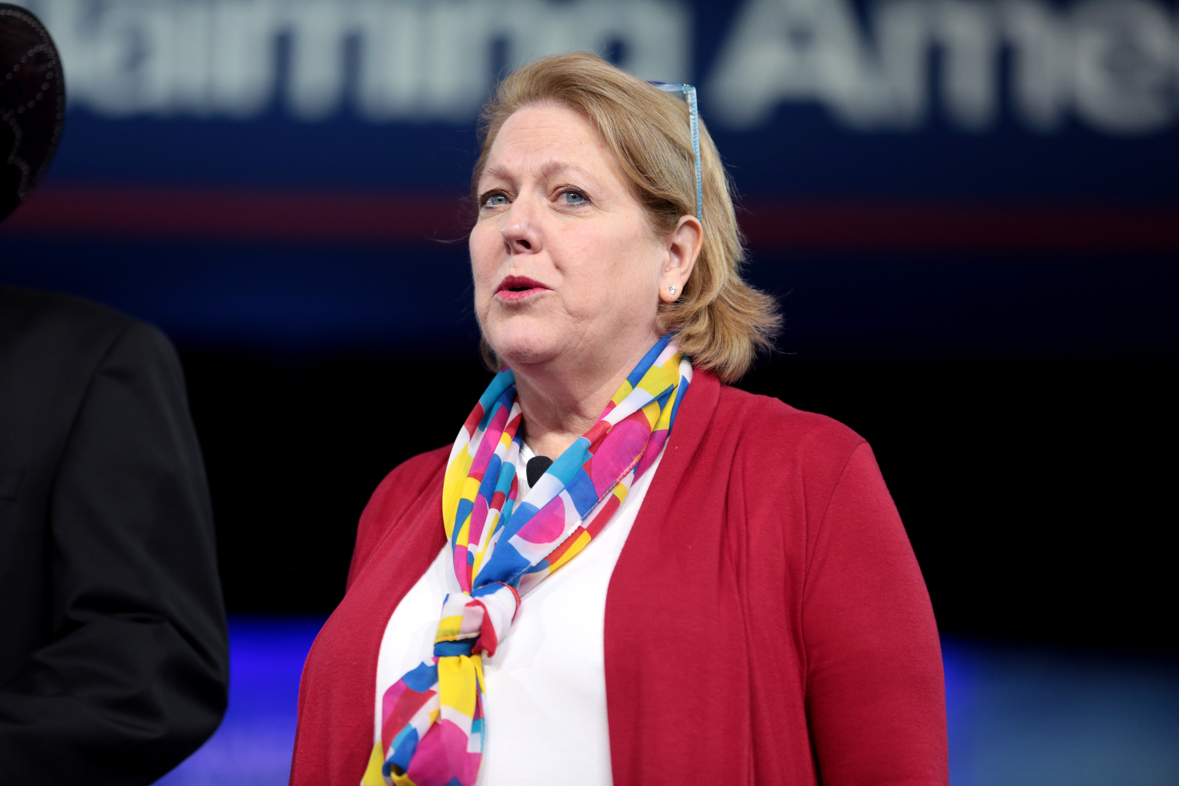
THE TRUTH
Notes:
THE TRUTH
Ginni Thomas has been a conservative activist since long before she met her husband. She had concerns about potential fraud and irregularities in the 2020 elections, and her minimal activity was focused on ensuring that reports of fraud and irregularities were investigated. Other than that, she played no role in the events after the 2020 election.
Despite this lack of involvement, the all Democrat-appointed January 6th Committee in Congress demanded to interview Ginni Thomas. She voluntarily met with the Committee for 4 hours, and answered every one of their questions to the best of her recollection.
She was not mentioned once in the Committee 845-page final report nor in any of the several hearings held by the Committee.
Also, it must be acknowledged that she is entitled to the same constitutionally-protected rights as the rest of us. She has a natural and legal right to hold opinions, voice those opinions, and associate freely, just as the spouses of other justices do.
Interesting Side note: Hollywood celebrities encouraged state electors to not cast their ballot for Trump in the 2016 election with no repercussions.

Slide 18

Lie #3: Political Corruption & Bias
Notes:
The third lie the left is pushing right now is that Justice Clarence Thomas should recuse himself from any January 6th case, or any case affecting President Trump, because of his wife’s political opinions.

Slide 19
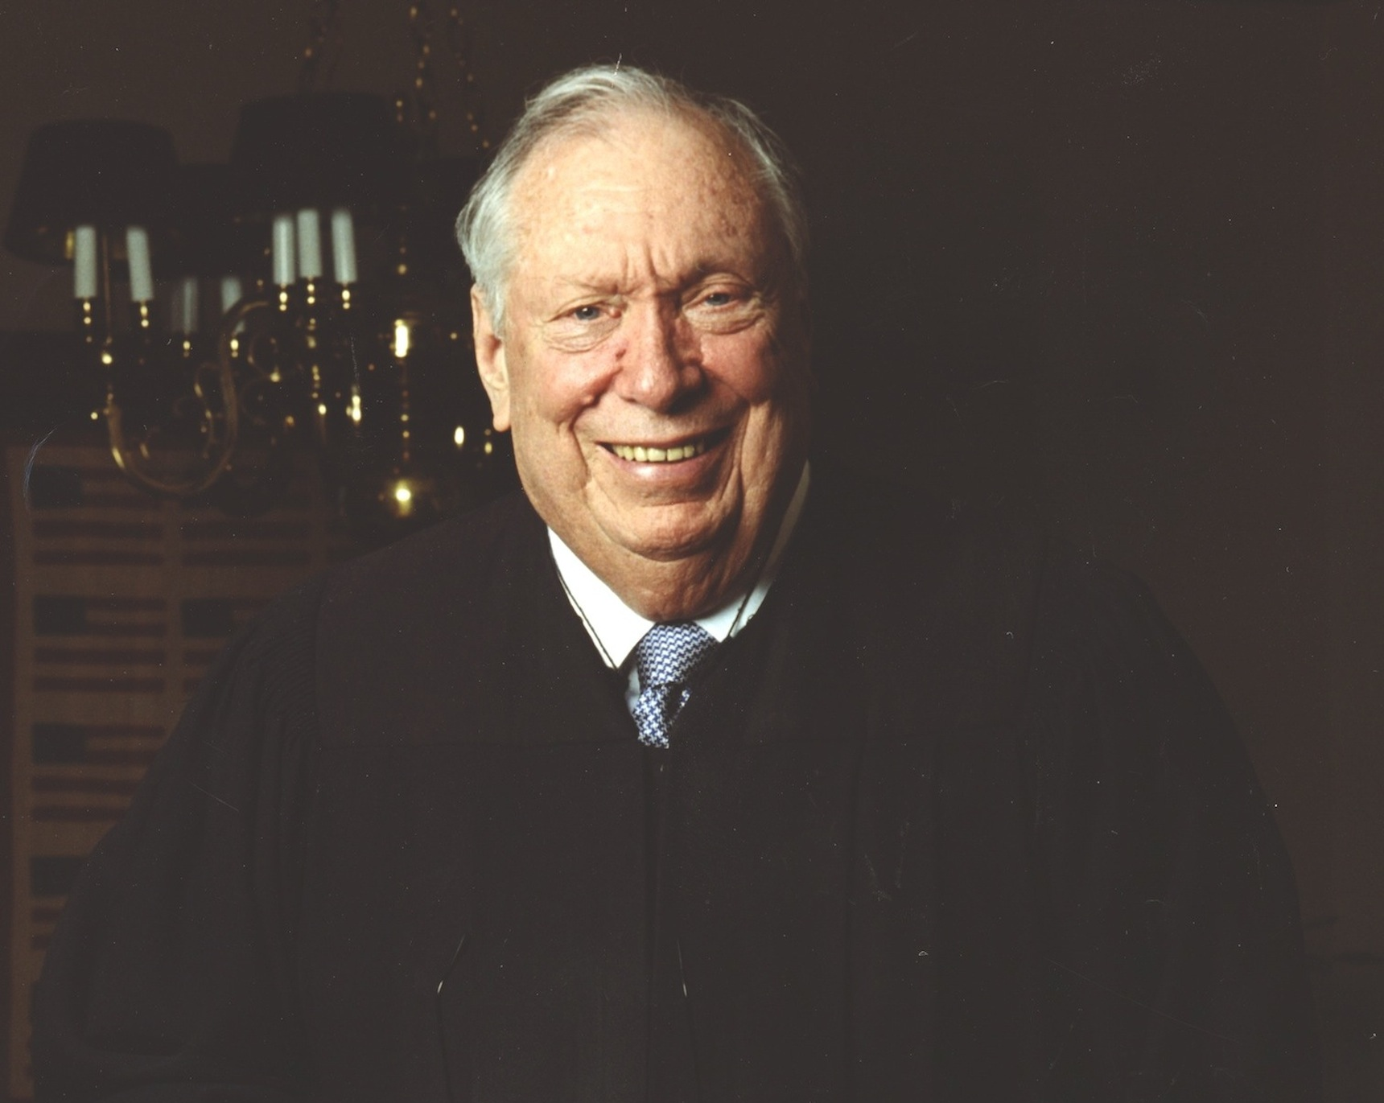
THE TRUTH
Notes:
THE TRUTH
Justice Thomas has NO reason to recuse himself from any Jan. 6th case or President Trump case based on his wife’s political activism. First, it’s not required by the law or precedent. Second, Democrats want to hold Justice Thomas to made-up recusal standards that have never applied to other judges.
In 2011, leftist Judge Stephen Reinhardt of the U.S. Court of Appeals for the Ninth Circuit refused to recuse himself from an appeal challenge to a same-sex marriage ban even though the ACLU-Southern California chapter (ACLU-SC), where his wife was Executive Director, joined two briefs in the district court proceedings urging the ban be struck down.
In fact, Judge Reinhardt was praised for the decision and five judicial ethics experts, including Professor Stephen Gillers, filed a brief in the U.S. Supreme Court supporting this decision.
And again, Justice Ginsberg directly supported pro-abortion groups in her own capacity - herself - and Justice Sotomayor has officiated same sex unions - herself, and neither have been pushed to recuse themselves on related cases. And yet, the left wants us to believe that Justice Thomas and Justice Alito should recuse themselves because of their wives' completely legal, constitutionally-protected actions and opinions.
So, no, Clarence Thomas does not need to recuse himself from any cases dealing with President Trump or January 6th because of his wife’s thoughts or opinions. Same goes for Justice Alito. There is no need for him to recuse. Period.

Slide 20
Where are we headed?
Notes:
Where are we headed?
All of these attacks against Clarence Thomas and other justices accomplish the left’s goal of weakening the American public’s confidence in the Supreme Court.
Why do they want us all to distrust the Court?
To soften us up to the idea that adding 4 justices would make the Supreme Court less biased and more fair.

Slide 21
What can you do to support justices unfairly attacked by the left?
USE OUR HOW-TO GUIDE to...
1. Call Senators
2. Contact state and local officials
3. Social influence
(letters to editor social media, sign waving, etc.)
Find our guide at: tpp.me/protectsc-howto
Notes:
What can you do to support justices unfairly attacked?
Call and email your U.S. senators with messages of support for Justice Thomas and Justice Alito. Tell them you oppose the efforts to bully them off cases and destroy their reputations. Ask them to use their platforms to publicly offer support for the justices and the Supreme Court as well.
Contact state and local officials and ask them to use their platforms to publicly express their support for Justices Thomas and Alito and for the Supreme Court. Ask them to pass a resolution to support them and oppose the efforts to bully them and destroy their reputations.
Write and submit letters to editors with the same messages, post on social media, email friends and family, hold sign waving events… any time or place you are able to correct the record, do it!

Slide 22
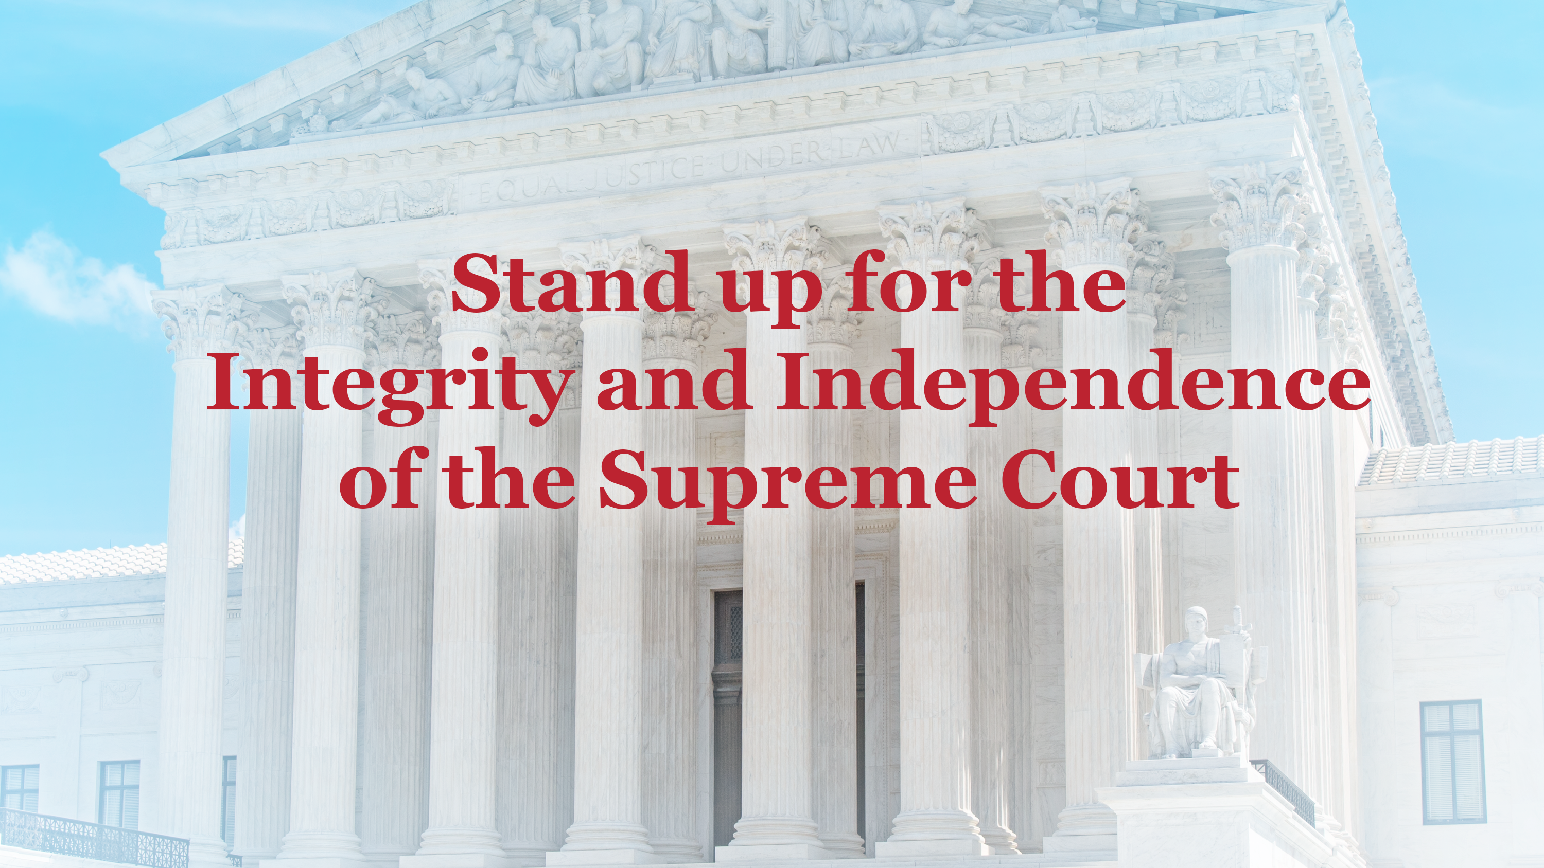
Notes:
Now we will discuss the second point in the left’s plan.
Increasing the number of Supreme Court justices from 9 to 13 - as long as Democrats are in power - is the left’s perpetual fantasy. It would allow Joe Biden, for instance, to “pack” the Court with just enough ideologically-aligned justices to ensure every left-wing policy was upheld, no matter how clearly it violated the Constitution.
This would be a fundamental shift that our constitution may not survive.
When President Trump appointed three justices during his term, due to vacancies, the left tried to call his fulfillment of a legitimate presidential duty as “court-packing.” In fact, they refer to their attempts to add 4 extra justices as “unpacking.”

Slide 23
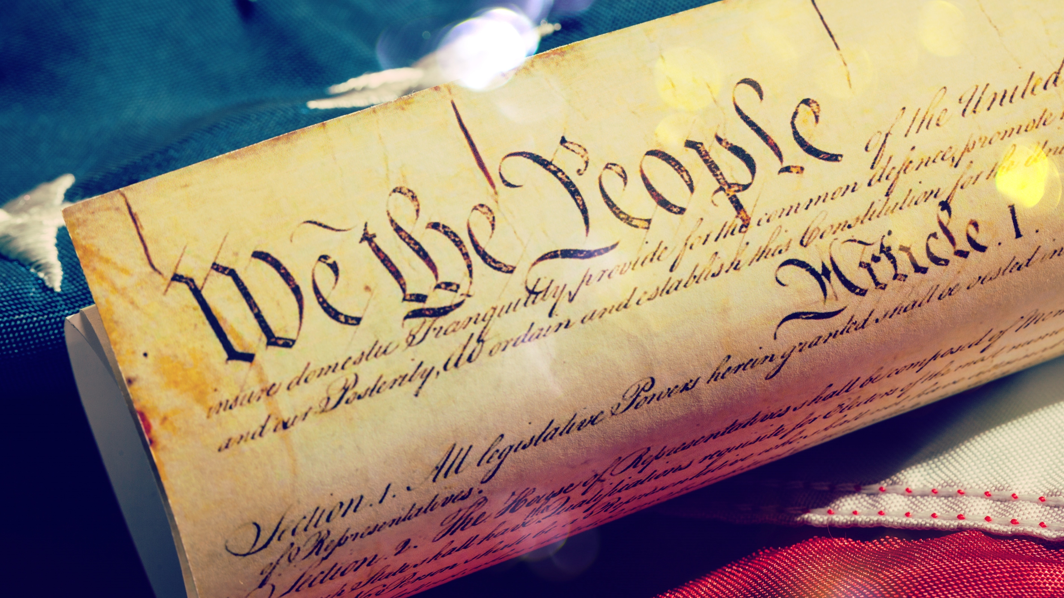
Notes:
The Supreme Court is supposed to act as a check on congress and the president, as a co-equal branch of the government.
Therefore, it is crucial that we are informed and educated about why court-packing is detrimental to our republic, and how it would eliminate the check the Supreme Court provides.

Slide 24
Lie #4: Everyone agrees that expanding the Supreme Court beyond nine justices will restore balance and trust to the Court.

Slide 25
The Truth
From the founding of the country, changing the number of justices was viewed with suspicion.
President Franklin Roosevelt tried to add justices and failed.
Notes:
THE TRUTH
As President Franklin Roosevelt pushed for his Court-packing legislation, the justices at the time spoke out publicly against it. After President Roosevelt successfully bullied two justices into siding with him and they upheld some of his New Deal policies, his Court-packing legislation was defeated in the senate 70-22. It was rejected by both Democrats and Republicans.
Before that, the Judiciary Act of 1789 set the Court at six justices. From then until 1869, the Court’s numbers shifted up and down based on the political mischief at hand. It wasn’t until it was set at 9 in 1869 - and remained at 9 - that the Court gained a stability and prestige it never had before.
While she was alive, very liberal Justice Ruth Bader Ginsburg also opposed expanding the size of the Supreme Court. She believed it would degrade the integrity of the Court, and rightly concluded that the American people would see the Court as nothing more than a political tool for the president to use at his whim.

Slide 26
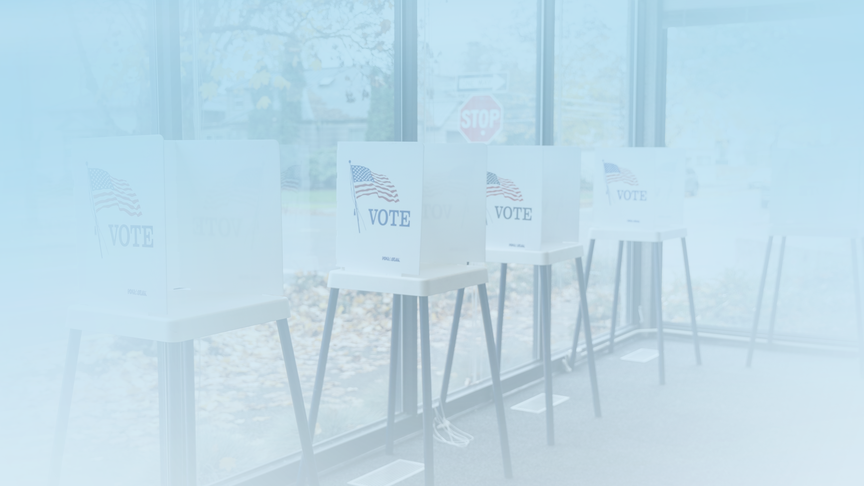
Court packing is an imminent issue,
and we are just one vote away from
this reality unless we win this election.
Notes:
The Supreme Court is supposed to act as a check on congress and the president, as a co-equal branch of the government.
Therefore, it is crucial that we are informed and educated about why court-packing is detrimental to our republic, and how it would eliminate the check the Supreme Court provides.

Slide 27
Notes:
Court packing is an imminent issue, and we are just one vote away from this reality unless we win this election.
Keep Nine is a proposed amendment to the constitution that simply states: “The Supreme Court of the United States shall be composed of nine Justices.” That’s it! That’s the full text of the amendment.
This amendment already exists in our Congress, and was first introduced by a Democrat in 2020. Since then it has garnered the support of more than 200 members of Congress.
Additionally, polling shows that voters would back this amendment by a 3-1 margin.

Slide 28
What can you do to support the Keep Nine Amendment and Protect the Supreme Court?
USE OUR HOW-TO GUIDE to...
1. Contact elected officials
2. Know your facts
3. Pass Resolutions
4. Expose and defeat “closet Court-packers”
5. Social influence
(letters to editor social media, sign waving, etc.)
Notes:
What can you do to support the Keep Nine Amendment and Protect the Supreme Court?
Reach out to your federal, state and local elected officials and ask them to endorse the Keep Nine Amendment.
Tell your friends about the Keep Nine initiative through emails, social posts and sign waving events.
Be ready with facts and truth when presented with opposition.
Pass local resolutions in support of the Keep Nine Amendment.
Expose and defeat “closet court packers” - those current elected officials who say they oppose court packing, but refuse to support the Keep Nine Amendment.
Our Protect the Supreme Court, stop Court-packing how-to guide has all the resources you will need to accomplish these actions.

Slide 29

If the left wins in November the pressure to pack the court will rise.
Patriots cannot let this happen.
Sign up to help secure and win the 2024 election at SecureAndWin.com.
Notes:
The next president may get to replace one or more justices and if the left wins, they will not be able to resist the pressure from their base and outside leftwing groups to pack the court.
Sign up to Secure and Win so that we are able to protect the Supreme Court and the United States from the left.

Slide 30
How-to Guides
We will have two separate how-to guides available to help you take action to protect the Supreme Court.
The first will help you defend Justice Thomas and other justices caught in the left’s crosshairs.
The second will help you educate Americans about the left’s efforts to pack the Court and stop them.

Slide 31
Thank you!
Thank you to our allies in this movement for assisting us with the information included in this presentation.
Mark Paoletta
Website: markpaoletta.com
Follow on X: @MarkPaoletta
Roman Buhler
Website: keep9.org
Follow on X: @Keep9Amendment
Notes:
Thank you to our allies in this movement for assisting us with the information included in this presentation.
Standing up for the justices under attack & integrity of the Court
Mark Paoletta is a partner at Schaerr Jaffe LLP, Senior Fellow at Center For Renewing America. Former Trump & Bush 41 Administration Lawyer; Former Chief Counsel for Oversight & Investigations for House Energy & Commerce Committee. He is the best-selling author of Created Equal: Clarence Thomas in His Own Words. Please visit markpaoletta.com for more information and follow him on X: @MarkPaoletta.
We cannot emphasize the importance of Mark’s work defending justices and the Supreme Court enough. His website and social media posts are a treasure trove of facts and details that we do not have time to include in this presentation.
Standing up to court packing attempts
Roman Buhler heads up the 'Keep Nine' initiative to prevent the progressive left from changing the number of justices and packing the Supreme Court. His efforts to protect the Supreme Court from the left’s efforts to destroy it are critical to keeping our republic. Please visit www.Keep9.org to read more about this initiative.

