Slide 1


onlycitizensvotemonth.com
Notes:
Hi everyone my name is Jennifer and I help coordinate Tea Party Patriots Action’s grassroots efforts across the country.
Welcome to this quick training to go over Only Citizens Vote Month, which is Tea Party Patriots Action’s nationwide push this August to get the SAVE Act over the finish line and ensure only citizens vote in our elections.
Let’s get right into it.

Slide 2

WHAT IS ONLY CITIZENS VOTE MONTH?
Tea Party Patriots Action has designated August 2025 as Only Citizens Vote Month to spotlight the Safeguarding American Voter Eligibility (SAVE) Act and build momentum for its inclusion in must-pass legislation.
The SAVE Act would close loopholes in the National Voter Registration Act and the Uniformed and Overseas Citizens Absentee Voting Act that currently allow noncitizens to register. It’s simple: 86% of Americans agree Only United States citizens should be allowed to vote in elections in America—and only by raising awareness and mobilizing action will our elected officials listen.
Notes:
Only Citizens Vote Month is all about one simple truth:
Only U.S. citizens should vote in U.S. elections.
That’s not controversial—86% of Americans agree. But believe it or not, there are loopholes in our voter registration system that allow noncitizens to register and vote.
That’s why we’re demanding passage of the SAVE Act—a bill that would close those loopholes and protect the integrity of our elections. And it’s our job to build pressure to get this bill attached to must-pass legislation.

Slide 3

WHY THIS ISSUE MATTERS
Notes:
Let’s get into why it matters

Slide 4
THE FEDERAL LAW GOVERNING VOTING & CITIZENSHIP
The Illegal Immigration Reform and Immigrant Responsibility Act of 1996 is a federal law that states it is unlawful for noncitizens to vote in federal elections.
Punishment for violating the law is a fine, not more than one year in prison, or both. Note: federal law also states that noncitizens who violate the law are inadmissible (ineligible to receive visas and ineligible to be admitted to the U.S.) and deportable.
This law does not apply to elections at the state or local level.
Source: Ballotpedia.org
Notes:
Federal law is clear:
Noncitizens are not allowed to vote in federal elections.
The Illegal Immigration Reform and Immigrant Responsibility Act of 1996 makes that a crime—punishable by fines or even jail time.
It also says that noncitizens who violate the law can be deported or ruled inadmissible to the U.S.
But here’s the problem:
That law doesn’t apply to state or local elections.

Slide 5
Noncitizens can potentially vote –
if the elections being held include offices other than federal;
If noncitizens are authorized to vote in the non-federal elections by state constitution or statute, or local laws; and
Source: Ballotpedia.org
Notes:
Noncitizens can legally vote in some local elections, depending on state or city laws.
And unless the federal ballot is clearly separated from local ones, they can easily vote in federal races without detection.
There are even exceptions in the law—like if someone mistakenly thought they were a citizen or has a parent who was.

Slide 6
THE EXCEPTIONS
(in the Reform and Immigrant Responsibility Act)
“It shall be unlawful for any alien to vote in any election... for Federal offices…” This does not apply to a noncitizen if –
each natural or adoptive parent is or was a citizen;
the individual permanently resided in the United States prior to reaching the age of 16; and
the individual reasonably believed at the time of voting in violation of the law that he or she was a citizen of the United States.
WHAT DO YOU THINK ABOUT THAT LAW?
Source: Ballotpedia.org
Notes:
Note for Presenter: #1 can be confusing. One scenario is a person has a parent who is a U.S. citizen, but you were born in another country. The person would be entitled to U.S. citizenship, but the parent never did the paperwork. The person was entitled to citizenship through birth, but doesn’t have citizenship because the parent never got a passport for the child at the embassy in that other country. This is something that does happen. This could happen with a naturalized citizen as well. The parent’s naturalized citizenship does not automatically confer onto the child.

Slide 7
THE FEDERAL LAW GOVERNING VOTER REGISTRATION
1993: The National Voter Registration Act (NVRA) requires states to accept the federal voter registration form. While the federal form contains a box to check, indicating the registrant is a U.S. citizen, there isn’t any language in the NVRA that actually requires proof/documentation be provided.
  As a result, the US Supreme Court has ruled that states may NOT require documentary proof of citizenship in order to register to vote in a federal election if the federal form is used (and remember, states are required to accept the federal form).
  Although there are penalties laid out in the law for registering to vote as a noncitizen, there seems to be little, if any, enforcement.
Source: Election Integrity Network, whoscounting.us
Notes:
The National Voter Registration Act of 1993—or NVRA—requires states to accept the federal voter registration form.
But that form does not require proof of citizenship.
It just has a checkbox. That’s it.
The Supreme Court ruled states can’t demand documentation if someone uses the federal form. So in reality, anyone can check that box and register—even a noncitizen.

Slide 8
The NVRA also requires state Department of Motor Vehicle (DMV) offices and social services agencies to register voters.
Which is why state DMVs automatically register everyone to vote unless they ‘opt out’.
Another form: REAL ID which requires proof of citizenship – IF the person is a citizen.
However, lawful permanent residents, nonimmigrants, asylum seekers, and various other categories of noncitizens are also eligible for REAL IDs.
Therefore, REAL IDs cannot be used to distinguish citizens from noncitizens.
Source: Election Integrity Network, whoscounting.us
Notes:
To make matters worse, DMVs and government agencies are required to offer voter registration—and in many states, it’s automatic unless you opt out.
And while REAL ID may require proof of citizenship, noncitizens can get them too—so REAL ID is not a reliable filter.

Slide 9
The overseas voting regulations are a mess too.
The Uniformed and Overseas Citizens Absentee Voting Act (UOCAVA): This federal statute allows people to register and vote by email –
  without a residence in the United States, and
  without any ID or proof of citizenship.
Source: Election Integrity Network, whoscounting.us
Notes:
Federal law also lets overseas voters register without proof of citizenship or U.S. residence.
And Biden’s Executive Order 14019 directed federal agencies—many of which serve noncitizens daily—to distribute voter registration materials to everyone they interact with.
Even if unintentionally, this opens the door to millions of noncitizens potentially being registered.

Slide 10
EXECUTIVE ORDER 14019
Joe Biden issued this EO on March 7, 2021
Ordered Federal Agencies, and those offices present within every state to provide registration information to everyone who came into contact with that office/agency.
Many federal agencies interact with noncitizens daily
Trump signed an EO to overturn 10419, however:
  There are (at least) over 21.7 million potential noncitizen voters
  According to the Census Bureau, almost 22 million noncitizens were residing in the U.S. in 2022, this dramatically increased under Biden’s open border
Notes:
In 2021, President Biden signed Executive Order 14019, requiring federal agencies to give voter registration info to everyone they interact with—including noncitizens.
These agencies serve millions of noncitizens every day.
Under Biden’s open-border policies, there are now over 21 million noncitizens in the U.S.
That’s a massive risk to election integrity.

Slide 11
STATE INFORMATION
All state constitutions mention U.S. citizenship regarding who can vote in that state's elections, though most do not specify who cannot vote.
As of March 2024, seven states specified that noncitizens may not vote in state and local elections: Alabama, Arizona, Colorado, Florida, Louisiana, North Dakota, and Ohio.
As of March 2024, the District of Columbia and municipalities in three states allowed noncitizens to vote in local elections. The three states are California, Maryland, and Vermont.
Currently, 19 States and DC Issue Driver’s Licenses to Illegal Aliens and every state issues Driver’s Licenses to noncitizens.
Source: Ballotpedia.org
Notes:
While all state constitutions reference U.S. citizenship, most don’t say who can’t vote.
Only seven states—like Florida and Arizona—explicitly ban noncitizen voting in all elections.
But others—like California, Maryland, and Vermont—allow it in local elections.
And that opens the door to abuse and confusion on mixed ballots.

Slide 12
The SAVE (Safeguarding American Voter Eligibility) Act
The SAVE Act will preserve the integrity of federal elections by ensuring that only US Citizens can participate in voting
Proposes amendments to the National Voter Registration Act:
  Requiring that proof of citizenship accompany the federal voter registration application that every state must accept.
  Mandating that states establish a program to remove noncitizens from their existing voter rolls using data provided by the Department of Homeland Security and the Social Security Administration at no cost to the states.
  Empowering U.S. citizens to bring civil lawsuits against election officials who fail to require proof of citizenship to register to vote in Federal elections.
  Creating criminal penalties for persons who knowingly register noncitizens to vote in Federal elections.
Notes:
That’s why we need the SAVE Act.
It would fix the federal loopholes by:
• Requiring proof of citizenship to register with the federal form
• Mandating states remove noncitizens from voter rolls using DHS and SSA data
• Empowering citizens to sue if election officials don’t follow the law
• And criminalizing knowingly registering noncitizens to vote

Slide 13
The SAVE (Safeguarding American Voter Eligibility) Act
State Level:
If an identiﬁcation or permit to drive is issued to noncitizens, ensure that it is clearly discernible as a noncitizen permit or identiﬁcation ONLY.
  Remember, noncitizens are not always illegally here. Some are legally in the USA, but they are still not allowed to vote.
Ensure that noncitizens are not being registered to vote at the DMV or other state agencies.
State election oﬃcials must create a process in cooperation with the DMV and social services agencies to ensure that noncitizen registrations are not included in the registrations forwarded from DMV and social services agencies to the state election oﬃces.
Notes:
It also addresses the state level by requiring clear ID distinctions for noncitizens and stopping automatic registration through DMVs or social services.
This isn’t about who’s here legally or illegally—
It’s about ensuring that only citizens vote in our elections.

Slide 14
POLL RESULTS
The vast majority of Americans agree that only citizens should register to vote and only citizens should vote.
In January 2024, Tea Party Patriots fielded a poll with McLaughlin and Associates about this issue.
  The poll, which surveyed 1,000 voters and was conducted January 25-31, 2024, found:
    87% agree that “proof of United States citizenship should be required to register to vote in American elections.”
    86% agree that “only United States citizens should be allowed to vote in elections in America”
You can visit our poll results page for a deeper dive into these results: tpp.me/noncitizenpoll.
Notes:
It also addresses the state level by requiring clear ID distinctions for noncitizens and stopping automatic registration through DMVs or social services.
This isn’t about who’s here legally or illegally—
It’s about ensuring that only citizens vote in our elections.

Slide 15
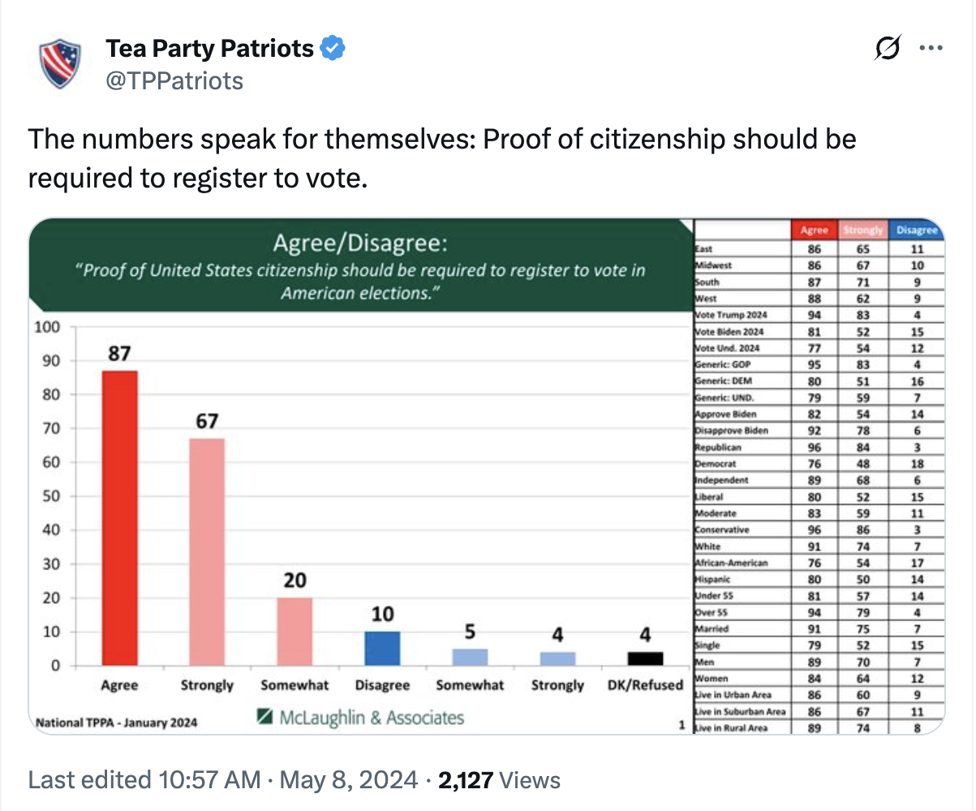
Notes:
That’s powerful. Use those numbers when you talk to others.

Slide 16
WHAT ARE WE DOING?
We’re asking you to host multiple activities throughout August—sign waves, ice-cream socials, phone-and-email campaigns, petition drives, letter deliveries, and tour-stop events. Every action you take builds the pressure to attach the SAVE Act to critical legislation, pass it, and send it to the President’s desk
Key Dates:
  August 9 & 15 → Neighborhood petition drives
  August 14-19 → Ice-cream socials and petition signings
  August 23 → Local sign-waving events
  September → Washington, D.C. press conference and petition delivery
Notes:
We’re asking patriots across the country to host:
• Sign-waving events
• Petition drives
• Ice cream socials
• Letter-writing campaigns
• And more throughout August
Key dates include petition drives on August 9 and 15, sign-waving on August 23, and a major press conference in D.C. in September.
We’ll cap it off with a national bus tour to carry your voices across the country.

Slide 17
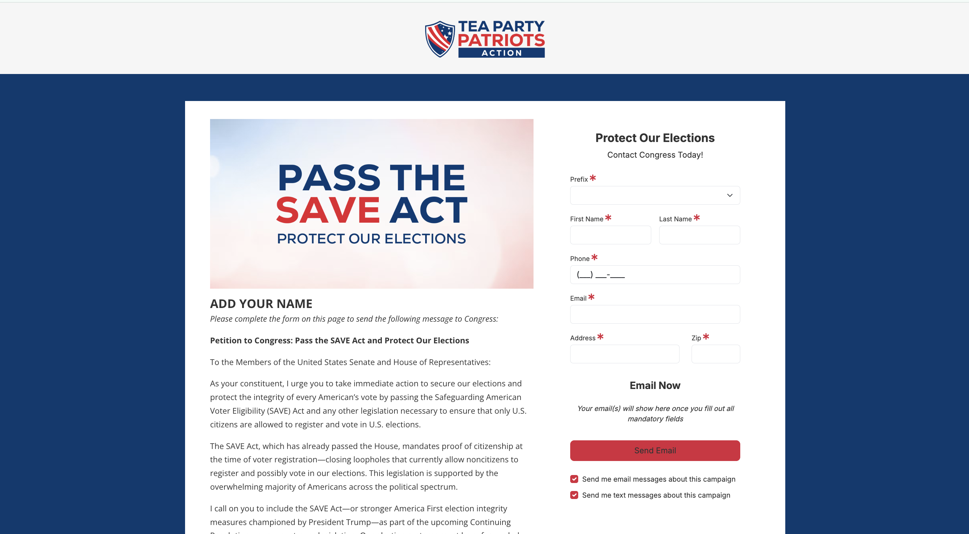
Notes:
Sign it online or print pdf

Slide 18
CALL TO ACTION- SHARE THIS!
Share this with your friends and family
  Invite others to sign up at OnlyCitizensVoteMonth.com
  Share on social media:
    America has massive loopholes in our voter registration system, and they must be closed. Support the SAVE Act and protect American elections! #OnlyCitizensVote
    Securing American elections means closing the loopholes that allow noncitizens to vote. The #SAVEAct does exactly that by closing gaps in our voter registration system. Tell your members of Congress to support the #SAVEAct!
Sign up to do one of the activities
  If you have signed up for the social and/or the sign waving, determine the date and time and let us know (we need a place where they can enter than info).
Visit OnlyCitizensVoteMonth.com for resources and materials
Notes:
Post on social media using #OnlyCitizensVote and #SAVEAct
Invite friends to join you, and share: OnlyCitizensVoteMonth.com.

Slide 19
THANK YOU!
For questions reach out to our team at support@teapartypatriots.org
Notes:
Thanks for taking action! Don’t forget to sign up for one of the activities I went over on OnlyCitizensVoteMonth.com
You’re making a real difference for election integrity and helping push the SAVE Act across the finish line.

